Slide 1
EAN ANNUAL CONFERENCE 2021
“A Practitioner’s View on how to rescue Tourism in Times of covid 19”
PRESENTER: NdiliMeke Imbili
27 October 2021

Slide 2
INTRODUCTION
A State of Emergency was declared by the President of Namibia on 17th March 2020 and it comprised of aggressive measures such as travel bans as well as country lockdowns, in order to contain the further spread of the pandemic.
Tours around the country, hotels, restaurants, crafters selling o the street markets & craftshops and all other tourism related businesses where all immediately & the first to be negatively affected.
Most of the tourism businesses being small & medium sized, have limited access to financial resources, hence found it very difficult to survive the extended travel bans.
Some closed had pay employees minimum possible rates or release them, those that were versatile traded in other sectors.

Slide 3
A number of efforts were made by the tourism industry in collaboration with our Minister of Environment, Forestry & Tourism, in order to revive the sector, of which some were successful. e.g. TRI, allowing visitors to enter our borders with negative covid results, being tested again after day 5, until it has improved to date that they only need to be tested again on departure.
Domestic Tourism was greatly activated with special rates being openly offered to Namibians.
A very minimal recovery was recorded.
With borders open now again, tourism is slowly picking up, however, lying flat on our stomachs, we first have to attempt to stretch up our hand to the ground, then get on our knees, before we eventually get back on our feet.

Slide 4
BACKGROUND OF XTS
XTS started operating in 2013
We are an owner managed, eco-friendly Destination Management Company that believes in practicing responsible & sustainable tourism, taking the UNDP 30 sustainable development goals
Xceptional Tourism services believes in service & customer oriented culture

Slide 5
USP’S OF XTS
100% owned by born and bred Namibians, which means we have deep rooted knowledge about all corners of Namibia.
We have over 28 years experience in tourism, ranging from Airline, Destination Management, Tour operation & Hospitality
We are flexible, give personal attention, always reachable and give attention to detail with all tours.
In addition to English, we speak German Spanish, French, Italian, Mandarin, Portuguese, etc.
We also speak a variety of the local languages, which enables better communication and interaction with the local communities, when undertaking cultural activities.

Slide 6
PRODUCTS & SERVICES
Destination Management Services
Sales & Marketing Services - Sign up fellow emerging entrepreneurs offering accommodation services, Activities, etc. to market their services to local, regional as well as international trade, direct, electronic & Trade Fairs
Etosha Omulunga Campsite & Self-catering, 30km north of Etosha, through the King Nehale Gate
Visa Services
Skills Transfer Training – Destination Management Training, incl. customer service training to Emerging Tour Facilitators / Booking Offices, etc.
Crafting Training on Introduction to Tourism, Volunteerism, Waste Management, Soft Skills to unemployed young adults, specifically residents of informal settlements.

Slide 7
5% of XTS profits will be donated towards the funding of the Pashukeni Foundation.
The core purpose of the Pashukeni Foundation is to:
uplift unemployed young adults, without formal education & are at the verge of giving up about having a better future.
change the mindset of young adults about taking better care of the environment, by better waste management and keep environment in which they live clean or spread the message in their community and where they go.
Teach young adults soft skills such as communication, team work, cv writing, etc.
Empower them with customer service training & business etiquette.
Importance of Tourism, raking them into our web & start practicing cultural tourism.
Offer Destination Management Training to those in the tourism industry / starting tour facilitating/ operating business/ booking agents etc.

Slide 8
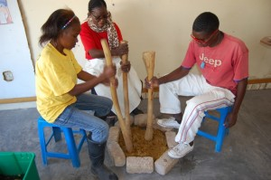
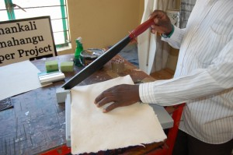
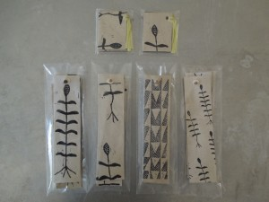
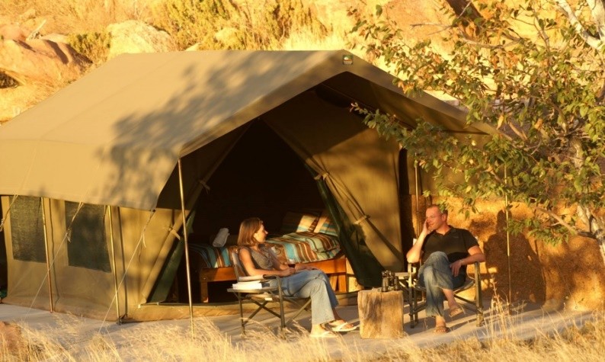
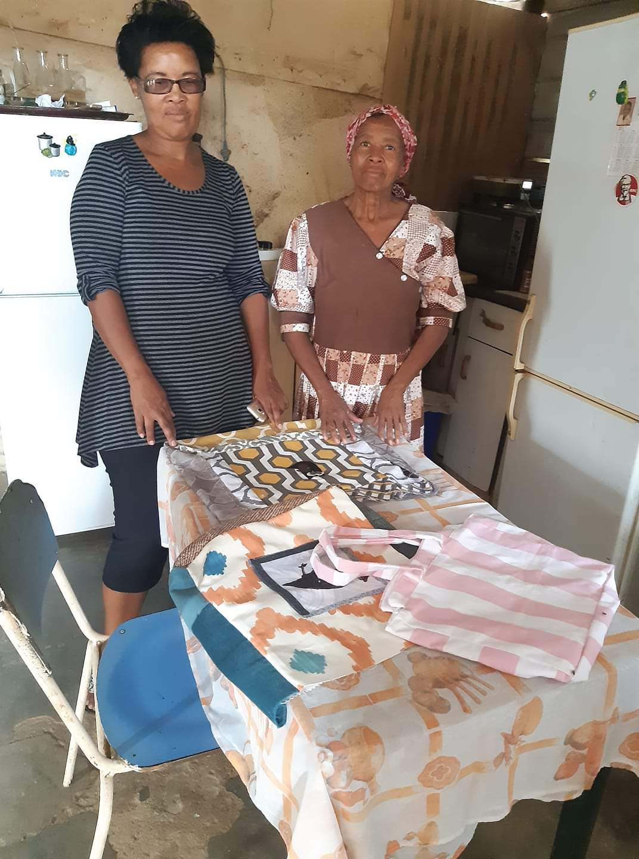
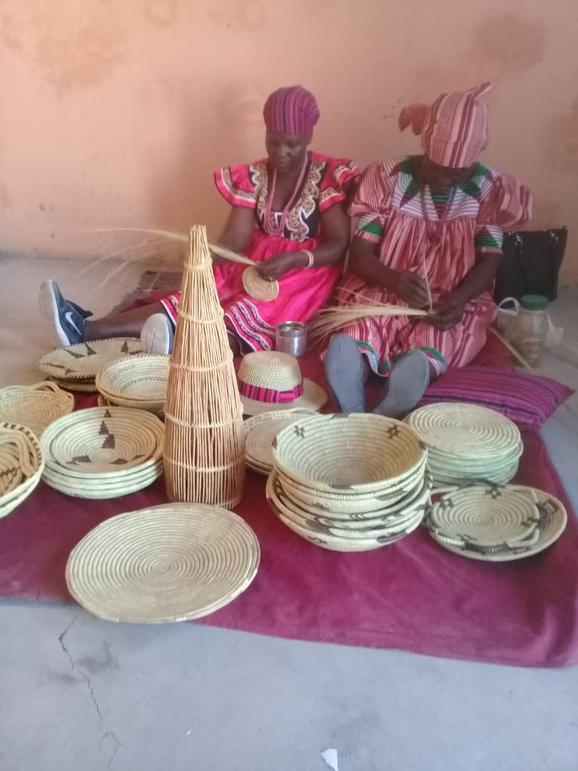
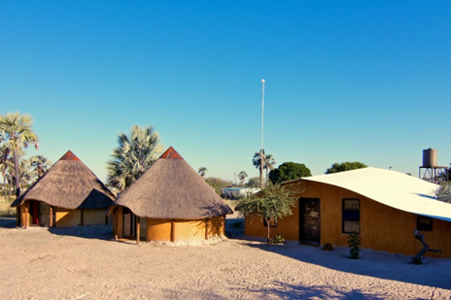
Sales & Marketing Services

Slide 9
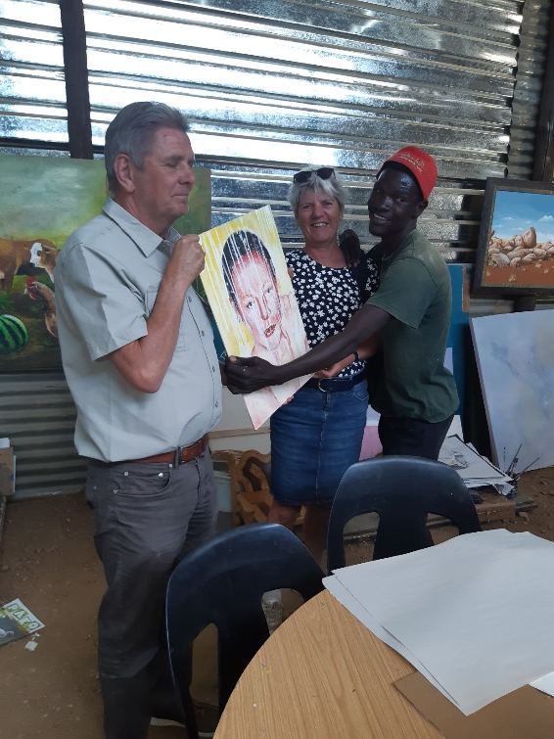
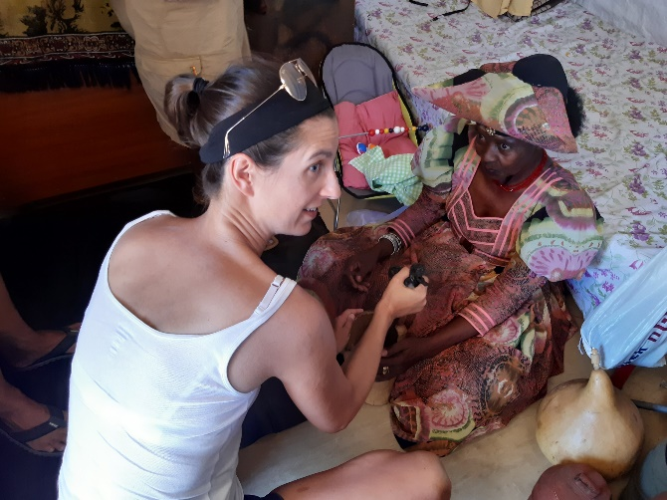
INTERACTIVE & CULTURAL TOWNSHIP TOUR
The Katutura Township Tour is crafted to uplift the living standards of the social entrepreneurs that we visit, by allowing them to sell directly to visitors.
We visit the Independence museum and other sites where we learn about the historical liberation struggle and the birth of Katutura; meaning
– A place we do not wish to stay, now a vibrant neighbourhood.
We visit various cultural groups and learn more about their culture as well as projects where community members are trained & empowered.
The tour can be extended to a lunch or sundowner / dinner option, where guests can enjoy cultural food.

Slide 10
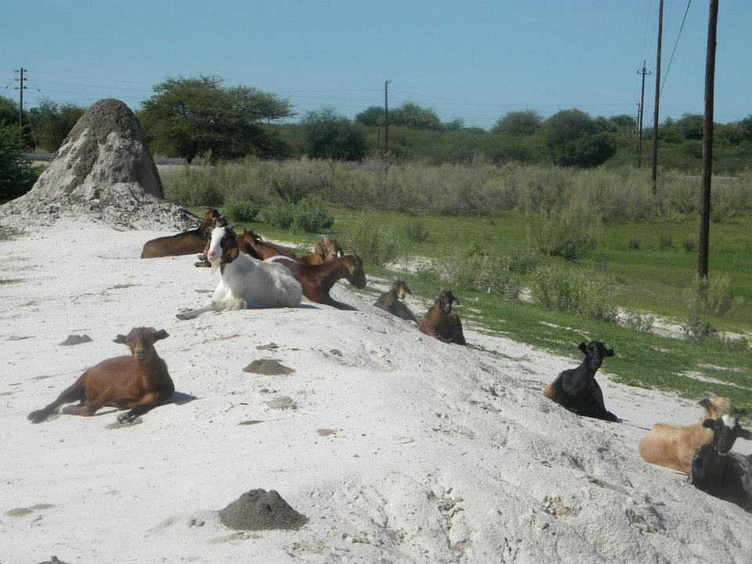
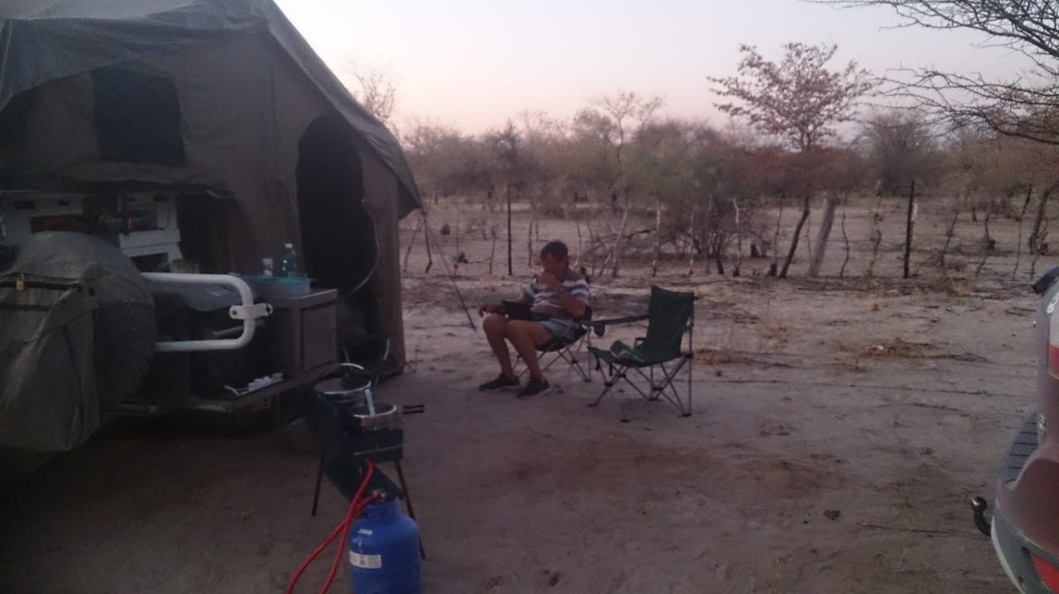
ETOSHA OMULUNGA CAMPSITE
Operating since Dec 2020
30km north of Etosha NP, via King Nehale Gate
Offering tours to nearby Aawambo Traditional Homestead, to learn about our cultures, traditions, way of life, etc.
Tour to neighbouring women projects / co-operatives manufacturing craft, paper manufacturing as well as oil producers
Guest Review: a month ago
https://goo.gl/maps/GJEePkytWL5sqARq7
Etosha Omulunga Campsite - Campground
If you want a bush experience, this is the place.
If you enjoy 4x4 on sand, then this should enthrall you. People are friendly.
Feels like you miles out of town but it's only 5 km. The stars are so bright there, because no lights around to dim them. Really enjoyed the experience and hope to go back. Good luck to the owner and may you grow from strength to strength.

Slide 11
covid 19 – March 2020
International Marketing Trip in Jan 2020, exhausting my last funds, with good calculations for return on investment.
I had just started to receive feedback from the marketing efforts, in Feb after some correspondence with potential clients, but none materialized as we all know.
While in hibernation and protecting ourselves from the deadly virus, I managed to compile the manual on Destination Management Skills Transfer Training for Emerging Tourism Entrepreneurs.
However, many entrepreneurs also ran out of financial resources and couldn’t afford the training anymore.
I also managed to write down my project proposal on the training of unemployed young adults.

Slide 12
I have however struggled to get commitment from my team of academics, for the crafting of manuals and am now hoping to work together with NUST graduates, who can also assist with training. They however also need some incentive.
I have been serving in my congregation council since 2006, mostly in informal settlements, alongside my elderly folk.
On 18 July 2020 an announcement was made in my congregation for those who wish to go study Bachelor of Theology to avail myself.
This was one of my long-term dreams, not realizing though that time was catching up with me.
I immediately enrolled, and am currently completing my second year of studies

Slide 13
Rescue in Times of covid
Capital injection for operational costs for next 2 Years.
Banks to allow clients to restructure their loans, extend payment leave, without crushing them.
Stop handing over businesses to debt collectors.
Stop repossession of assets
Stop ITC listing
VAT refunds to be paid out ASAP
RFA to offer a grace period for car discs while business picks up as well as cancel all interest charged within this period.
Social Security to increase covid relief assistance claim as most tourism companies employees are professionals who earn over N$ 6,000.

Slide 14
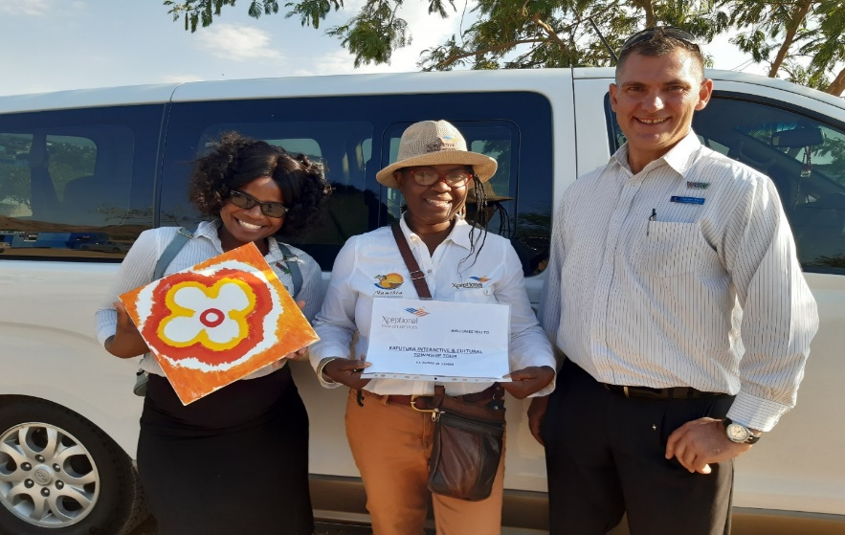
THANK YOU FOR THE OPPORTUNITY
MOBILE: +264 85 739 8000

