Slide 1
Namibia Investment Promotion and Development Board - NIPDB
Ms. Chaze Nalisa - Manager: MSME Capacity Building and Market Access

Slide 2
Our Vision
We exist to unlock opportunities and
enable a better quality of life for all
Namibians

Slide 3
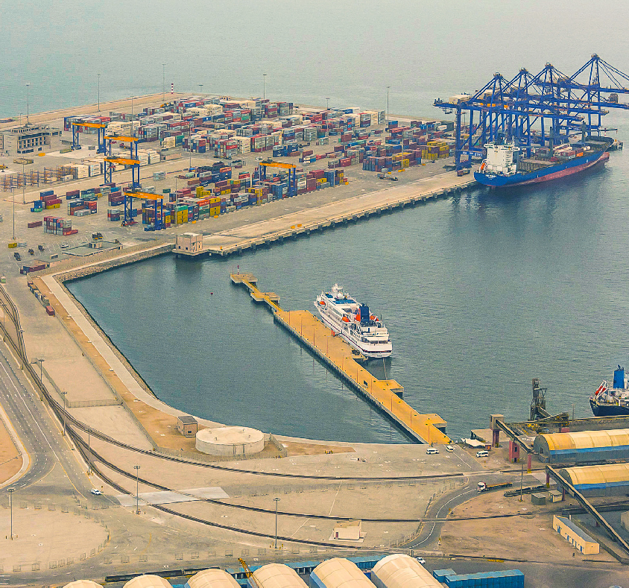
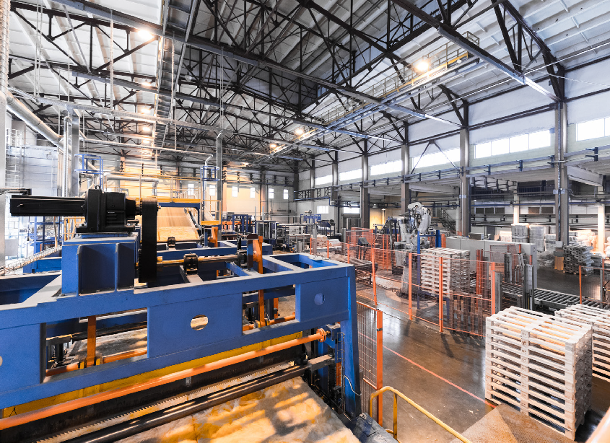
OUR PRIORITY SECTORS
Renewable Energy
Food Industry
Chemicals & Basic Materials
Transport and Logistics
Services
(Digital and Global Business)
Renewable Energy
Food Industry
Chemicals & Basic Materials
Transport and Logistics
Services (Digital and Global Business)
Metals, Mining & Adjacent
Machinery & Electronic
Fintech
Tourism
Exploration (Mining and Oil & Gas)
Metals, Mining
& Adjacent Industries
Machinery & Electronics
Fintech
Tourism
Exploration (Mining and Oil & Gas)

Slide 4
Common market access challenges
Limited Financial Resources:
Small businesses often struggle with limited financial resources, making it difficult to invest in marketing, distribution, and meeting regulatory requirements for market access.
Market Information and Research:
Limited access to market information and research can make it challenging for small businesses to understand customer needs, market trends, and competitive dynamics, hindering their ability to tailor products and services effectively.
Regulatory Barriers:
Compliance with regulations, licensing, and certification requirements can be cumbersome and costly for small businesses. Navigating through bureaucratic processes may pose challenges for startups and smaller enterprises.
Limited Access to Technology:
Many small businesses may lack access to modern technologies that could enhance their productivity, marketing efforts, and overall competitiveness in the market.
Skills and Training:
The skills gap among the workforce may be a challenge for small businesses. Limited access to training programs and a shortage of skilled labour can affect the quality of products and services.

Slide 5
Common market access challenges
Access to Finance:
Limited access to financing options can hinder the growth and development of small businesses. Financial institutions may perceive them as risky, making it challenging to secure loans or other forms of capital.
Competition from Larger Enterprises:
Small businesses often face intense competition from larger, more established enterprises. This can make it difficult for them to capture market share and establish a strong presence.
Networking and Collaboration:
Limited networking opportunities and collaboration platforms can hinder the ability of small businesses to connect with potential partners, suppliers, and customers. In-bound and outbound business delegations are advisable.
Cultural and Social Factors:
Understanding and adapting to local cultural preferences and social dynamics is crucial for business success. Small businesses may face challenges in tailoring their products and services to meet the specific needs of the local market.

Slide 6
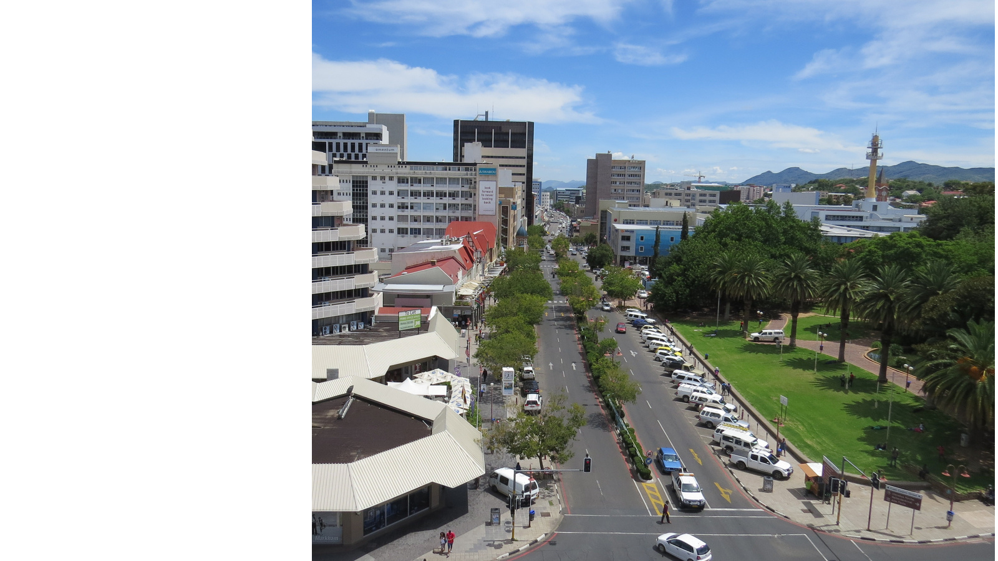
Our MSME Mandate
Coordinate MSME activities across all
levers of the economy and implement

Slide 7
Our Goal
“Delivering Targeted support for the scalability of MSMEs and Start-ups.”

Slide 8
Our Focus Areas
1
Finance
2
Information
3
Capacitation
4
Scaling
5
Startups
6
Building Networks
7
Policy advocacy
8
Market access

Slide 9
What is key for enterprise owners (MSMEs)
Market Research
Understand Regulations and Compliance
Build a Strong Online Presence
Secure Intellectual Property Rights
Explore International Partnerships
Adapt Marketing Strategies
Logistics and Supply Chain Management
Compliance with International Standards
Understand Currency Risks
Offer Consistently Excellent Customer Service
Network and Seek Assistance
Stay Informed About Global Trends
Risk Management
Continuous Learning and Adaptation

Slide 10
MSME Support initiatives
ECOSYSTEM OPTIMISATION (EO)
Landscape Assessment
Business Support Organisation Mapping
MSME Mapping
Chelete Cage
Policy Advocacy
BUSINESS ADVISORY SERVICES (BAS)
Digital Bootcamps
Business Support Hubs
Financial Symposiums
Branding Master Class
SheRebuilds Her World
MSME Business Idea Generation
START UPS
Engaged local and regional entrepreneurial and innovation stakeholders
Strategically strengthening local (Namibia) and regional (Africa) innovation ecosystem players & organisations
CAPACITY BUILDING AND MARKET ACCESS (CBMA)
NextGen Entrepreneurs Showcase
Technovation Social
High Potential Pool
Namibia Department Store

Slide 11
Gateway to international markets
Southern African Development Community (SADC):
The SADC is a regional organization aiming to promote economic integration and cooperation among its member states. Namibian small businesses can benefit from improved market access, reduced trade barriers, and a more harmonized regulatory environment. Sectors such as agriculture, manufacturing, and services stand to gain by tapping into the regional market.
Southern African Customs Union (SACU):
SACU, a customs union comprising Botswana, Lesotho, Namibia, South Africa, and Eswatini, eliminates internal tariffs and promotes a common external tariff. Namibian businesses can explore opportunities for intra-regional trade, particularly in industries such as mining, manufacturing, textile and agriculture.
African Continental Free Trad Area (AfCFTA):
AfCFTA is a game-changer for the entire African continent. Namibian small businesses can access a market of over a billion people, promoting diversification and expansion. Key sectors include agribusiness, renewable energy, and technology. Enhanced collaboration and market access can lead to sustainable economic growth.

Slide 12
Gateway to international markets
African Growth and Opportunity Act (AGOA):
AGOA provides preferential trade benefits to eligible African countries. Namibian businesses, by complying with AGOA requirements, can access the U.S. market with reduced tariffs. Textiles, apparel, and agriculture are promising sectors, and the act promotes job creation and skill development.
Economic Partnership Agreement (EPA):
Namibia, as part of the SADC-EU EPA, gains duty-free and quota-free access to the European Union market. Small businesses in Namibia, particularly in fisheries, agriculture, and manufacturing, can benefit from preferential access to one of the world's largest consumer markets.
Southern Common Market (Mercosur):
Mercosur, a South American trade bloc, presents opportunities for Namibian businesses to access markets in countries like Brazil and Argentina. Agriculture, mining, and technology are sectors where partnerships and market exploration can yield fruitful results.

Slide 13
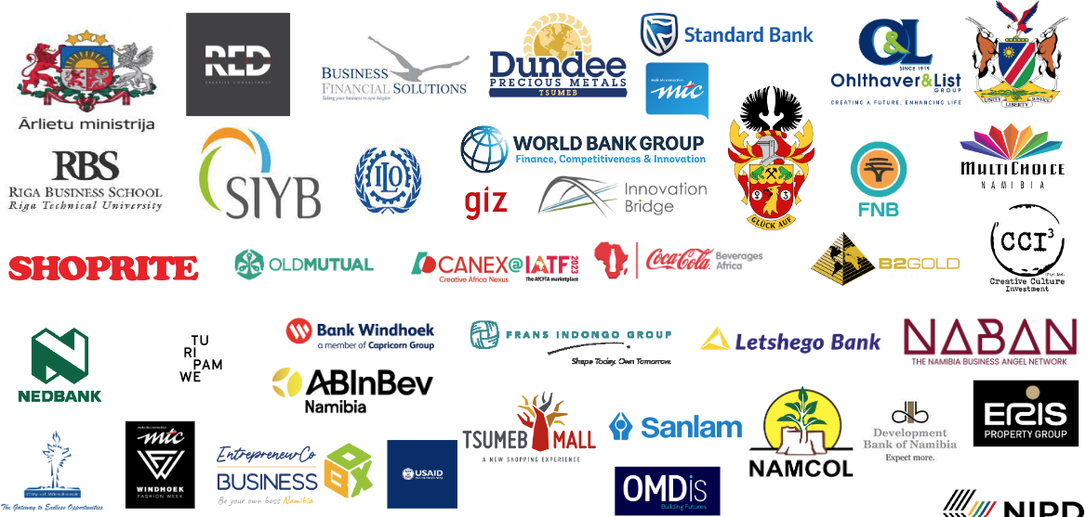
Our Fellow Enablers
Ryunosuke Satoro

Slide 14
Thank You

