Slide 1
Unlocking growth
Sepo Haihambo

Slide 2
Capital-what is it?

Slide 3
Different stages of business require different types of funding
Bootstrapping
Crowd funding/Friends & Family
Venture Capital/Angel Investors
Private Equity
Debt

Slide 5
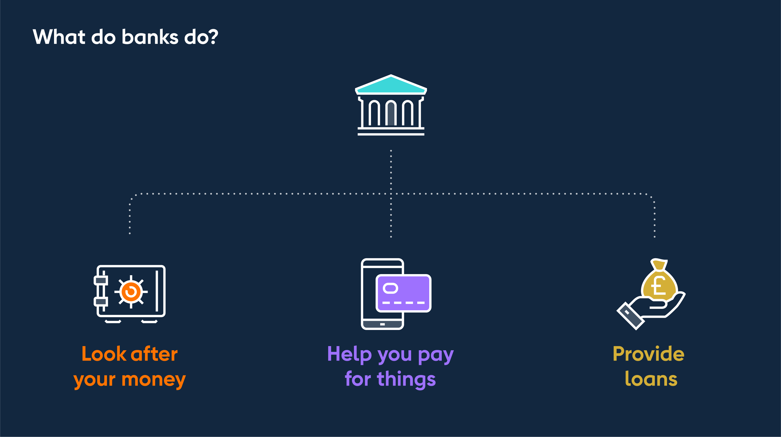
What do banks do?

Slide 6
Bankable deals
Business governance in place
Track record & experience
Good customers
Steady source of cash flow
Affordability
Sector prospects

Slide 7
Questions…..

