Slide 1
Readiness of R&D and capacity building
Prof. Dr. Anicia Peters
Chief Executive Officer
National Commission on Research, Science and Technology, Namibia

Slide 2
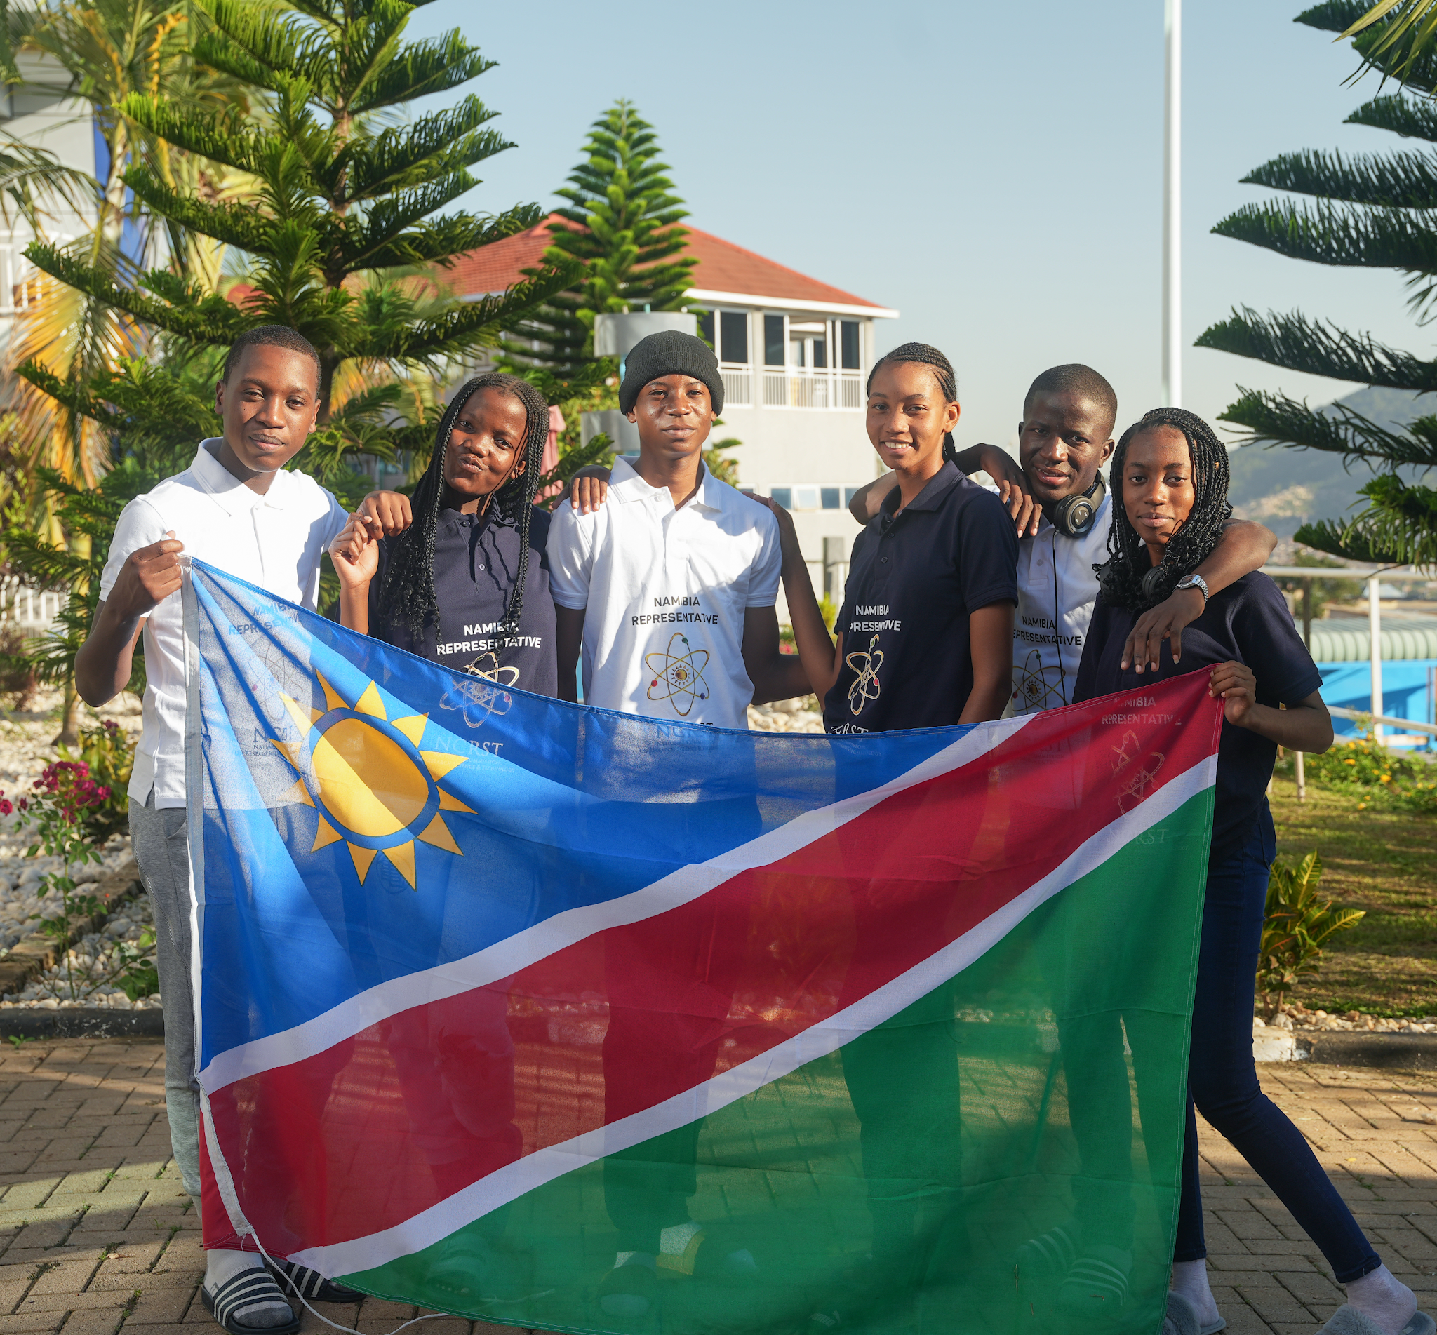
Overview
Research, Science and Technology Act No 23 of 2004
Established NCRST and National RST Fund
Coordinate, promote & develop research, science, technology & innovation (RSTI)
RSTI Funding
National facilities
National RSTI data
Councils (e.g. biosafety council, space council, IKS council)
Development of National Programme on Research, Science, Technology and Innovation (National Research Agenda)

Slide 3
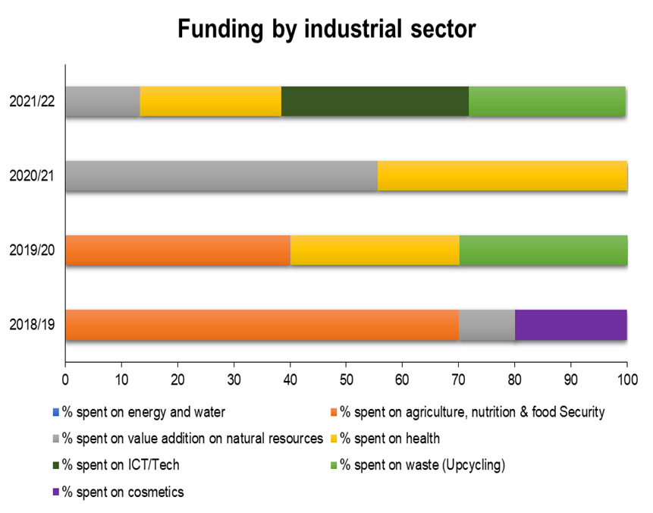
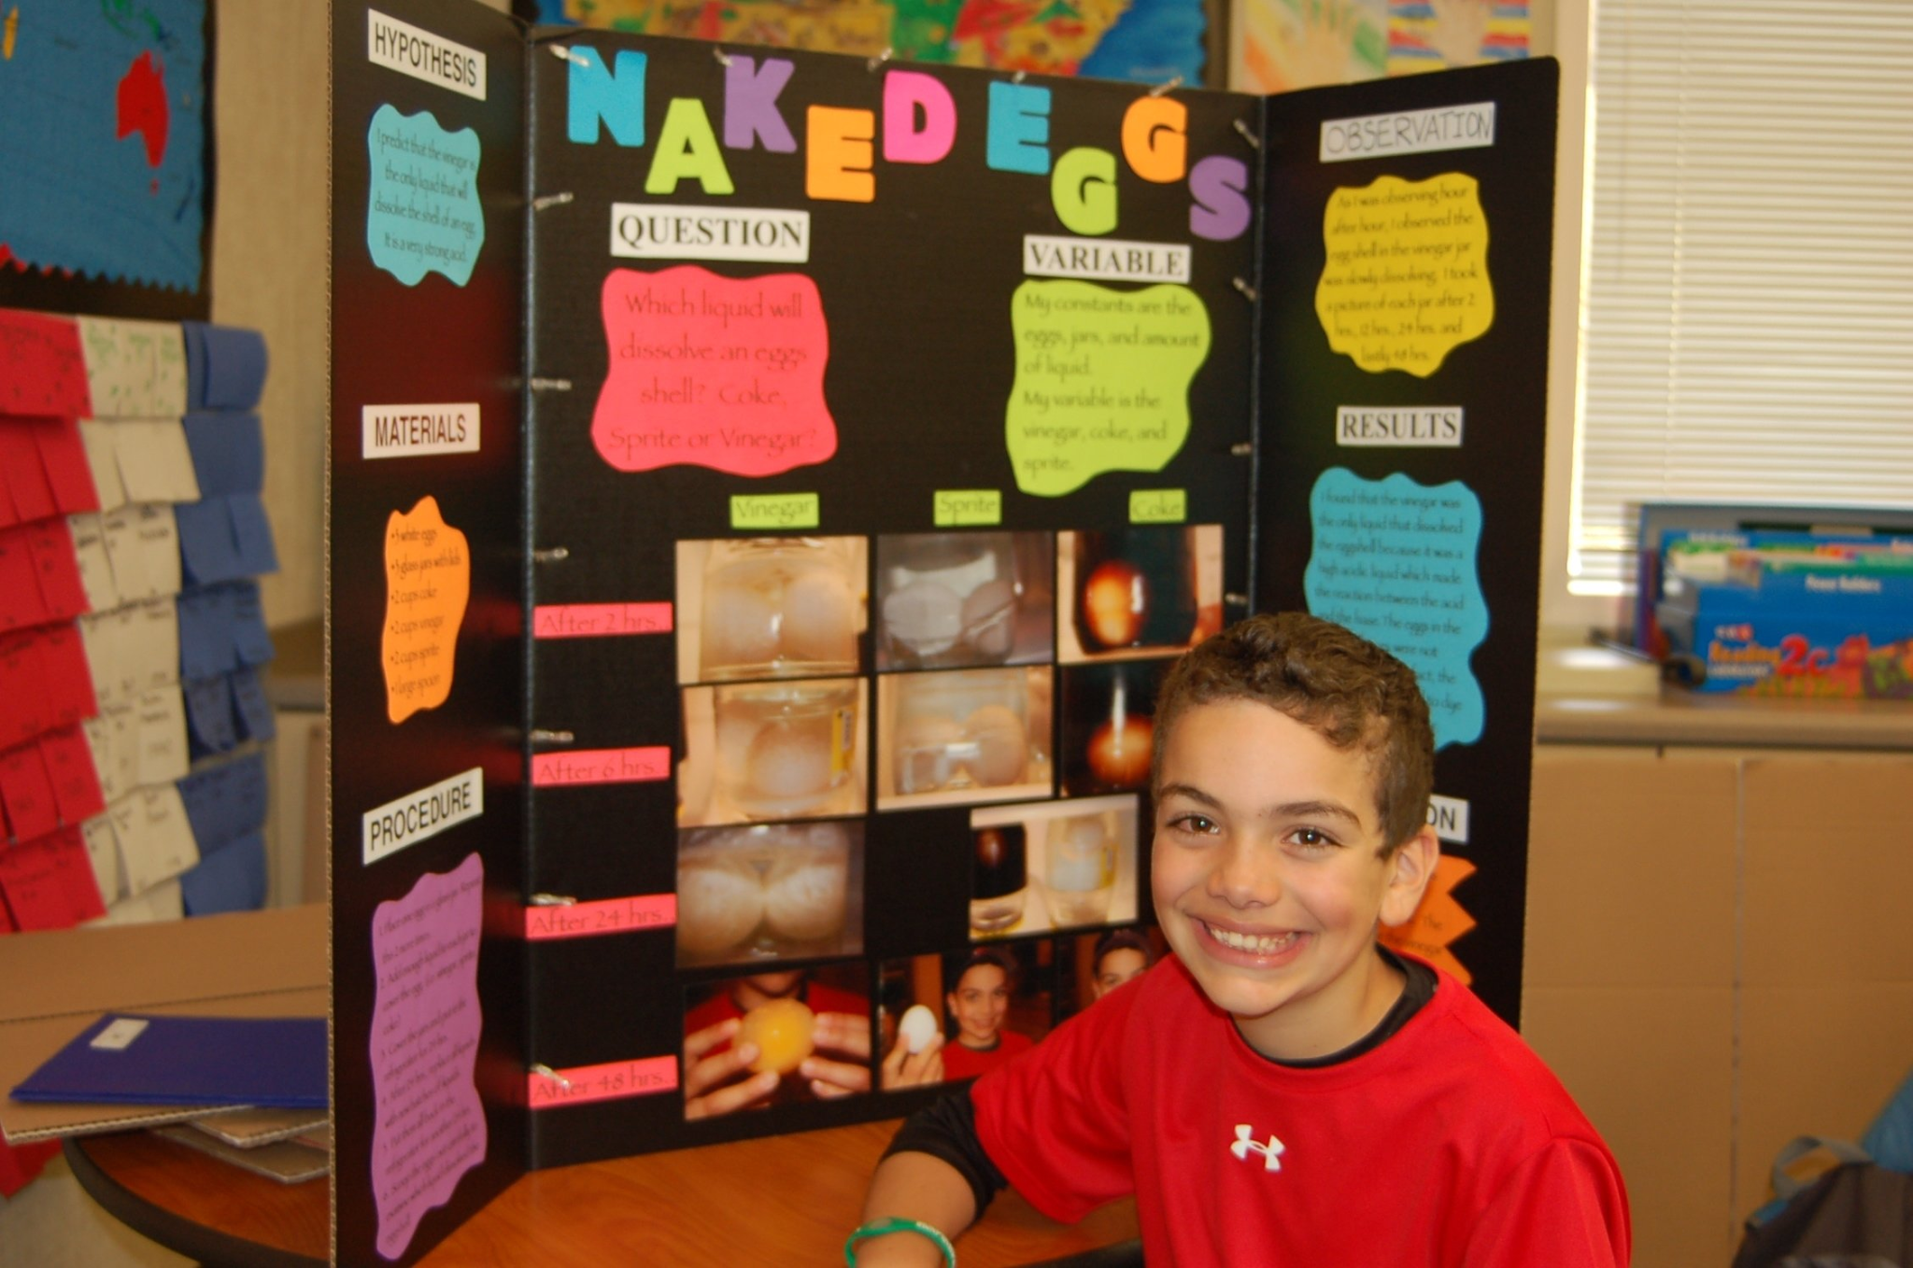
National Maths Olympiad
National Space Week
National Science Week
Innovation
Programmes
STI
National Science Fair
National Innovation Survey

Slide 5
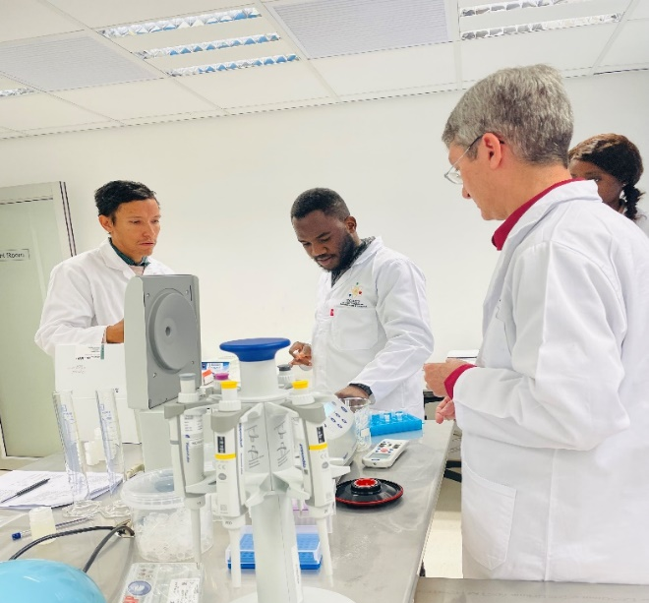
National Research Agenda: Oil and Gas
Defines priorities for RSTI in Namibia, especially research priorities – oil and gas
Outlines research and interventions to be undertaken
Outlines research calls: funded, unfunded, partially funded
Research Infrastructure - national
Research Chairs in specific areas in Oil and Gas
Seed funding
Post docs, PhD and Master students
Equipment
Consortia
Research/er capacity development
Pilot projects

Slide 6
Capacity Building: Considerations
R&D in oil and gas, synthetic fuels and green hydrogen is specialized and capital intensive
Namibia R&D survey: less than 3000 FTE researchers in the country
Mix of formal degrees, vocational training, apprenticeships, internships, short certifications required
Certification & accreditation important – trainer, trainees, equipment
Specialized academies and national research facilities needed
Multiple areas to be covered (Strategy and Masterplan to 2030 and beyond), e.g.
Contingency planning, disaster and risk management
Environmental concerns
Technological innovations
Regulatory and Policy factors
Community impact
Market impact
Diversification strategies
Evaluate memberships to international bodies and signing treaties, e.g Global Subsea Response Network
Collaboration and knowledge-sharing important nationally and internationally

Slide 7
Thank you

