Slide 1
Pre-Budget 2024/25
20 February 2024 THE ELECTION YEAR

Slide 2
The Election Year: 2024
Global Trends : Elections Vs Economic Performance
Global & Regional Outlook
Domestic Performance & Outlook Comparative Analysis Historic Fiscal Policy
2024/25 Budget Expectations

Slide 3
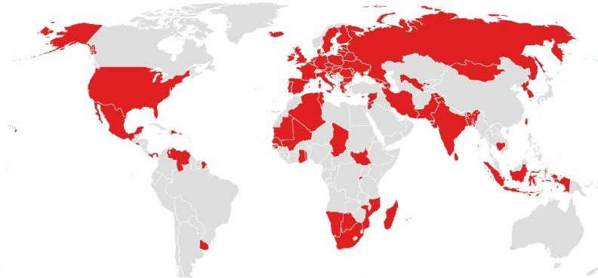
Election Countries: 2024

Slide 4
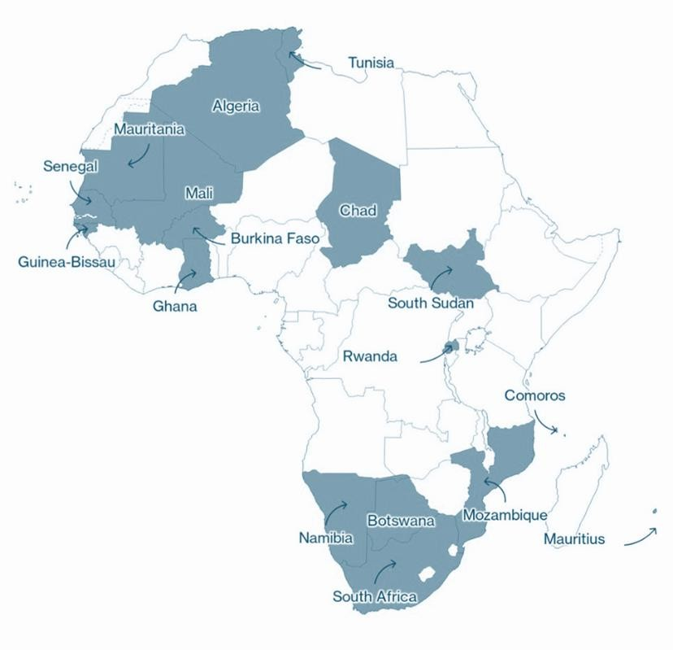
African Countries due to have elections in 2024

Slide 5
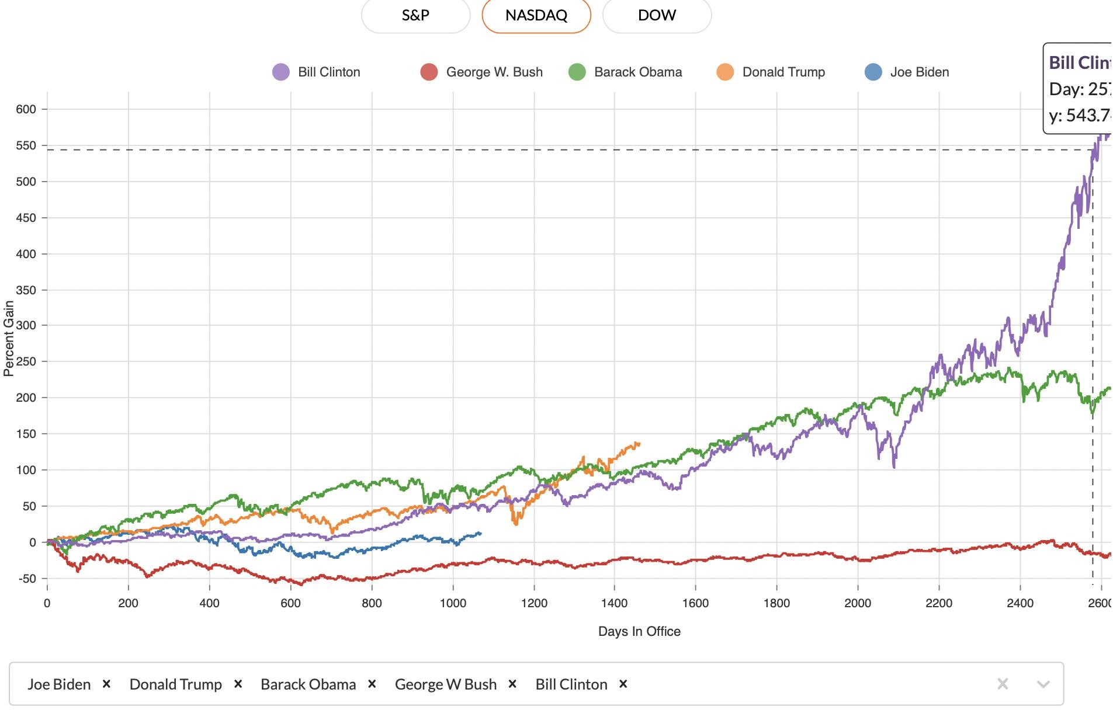
Stock Market Performance: US

Slide 6
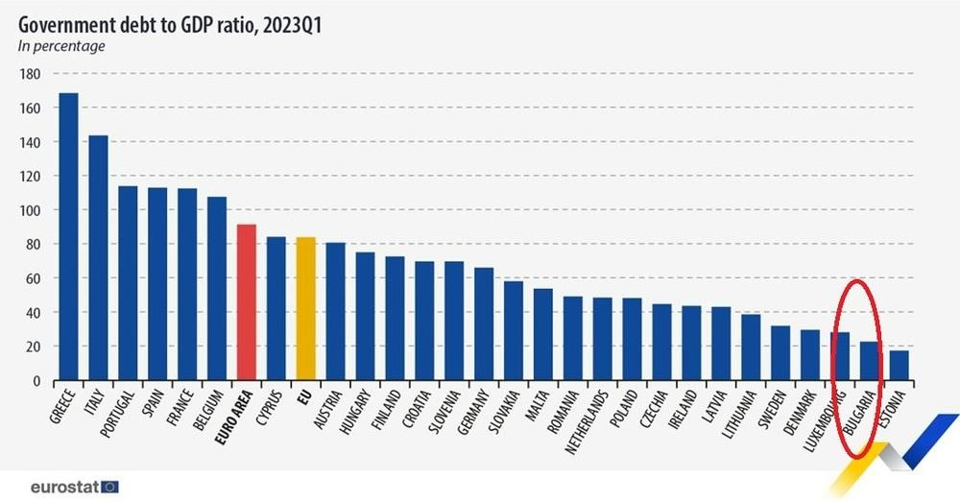

Slide 7
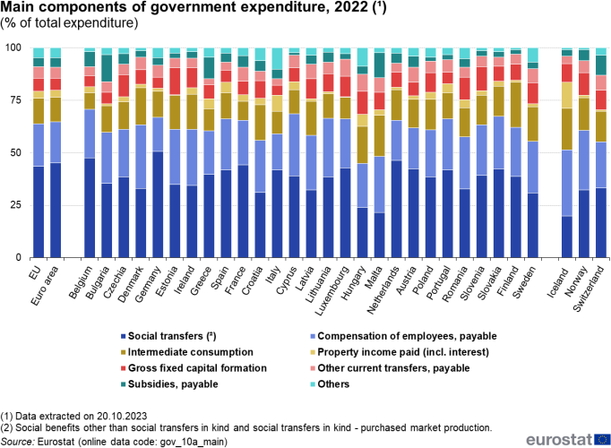

Slide 8
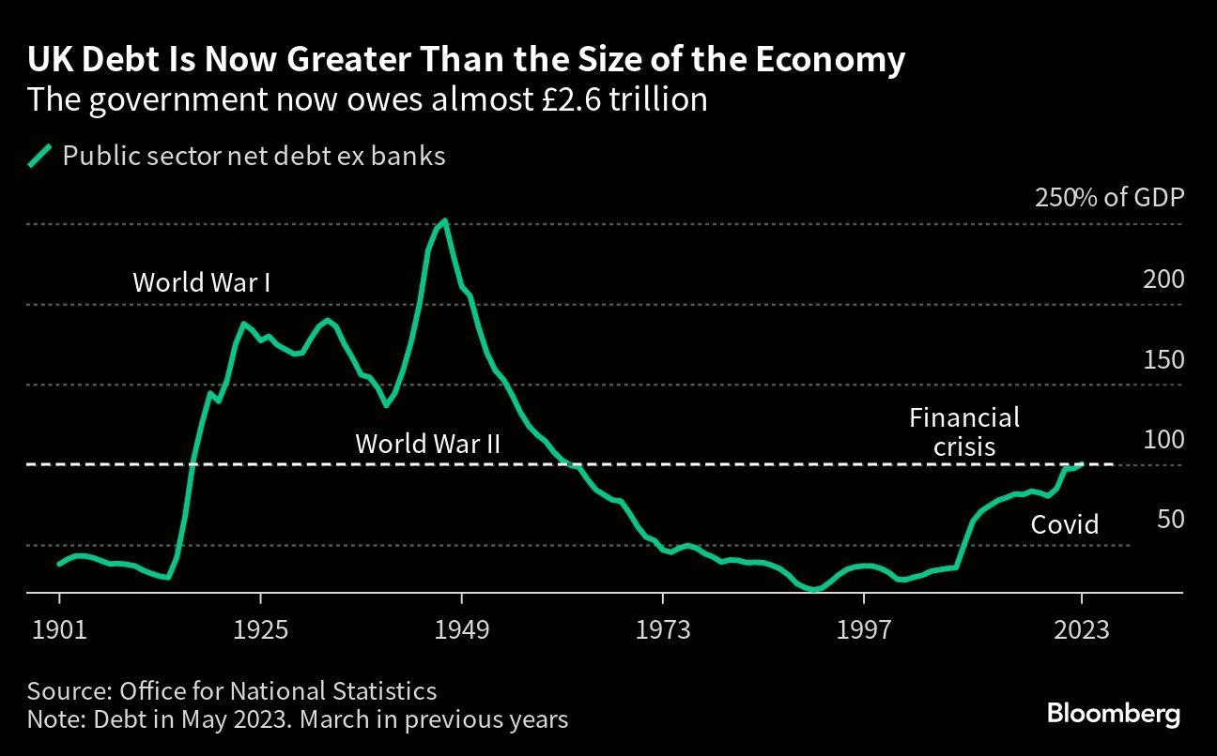

Slide 9
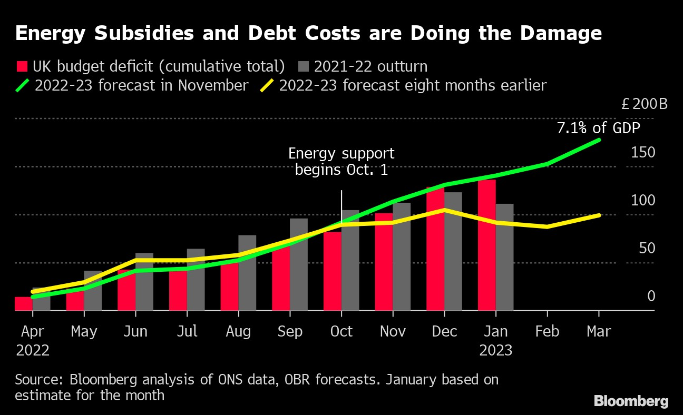

Slide 10
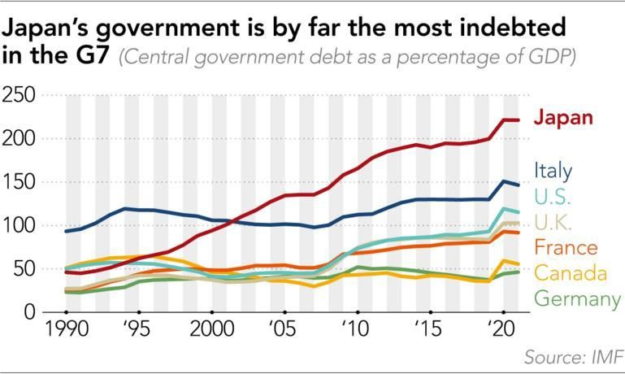

Slide 11
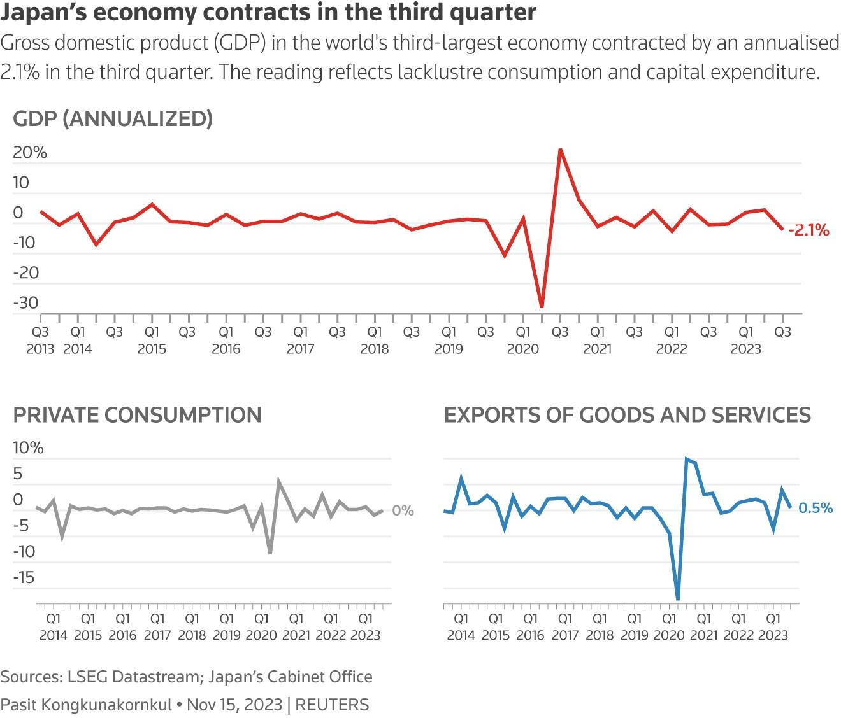

Slide 12
South Africa National Debt to GDP
80
73.67
Cyril Ramaphosa
70
60
Nelson Mandela
44.8 44.7
51.54
50
Jacob Zuma
48.6
42.2
Thabo Mbeki
%
40
30
27
24
20
10
0
1993 1994 1995 1996 1997 1998 1999 2000 2001 2002 2003 2004 2005 2006 2007 2008 2009 2010 2011 2012 2013 2014 2015 2016 2017 2018 2019 2020 2021 2022 2023

Slide 13
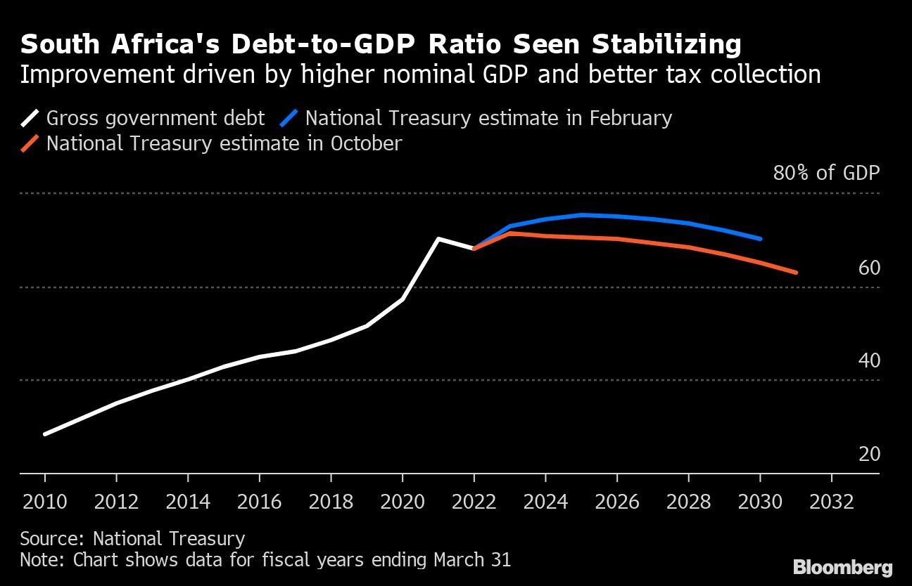
SA Debt to GDP

Slide 14
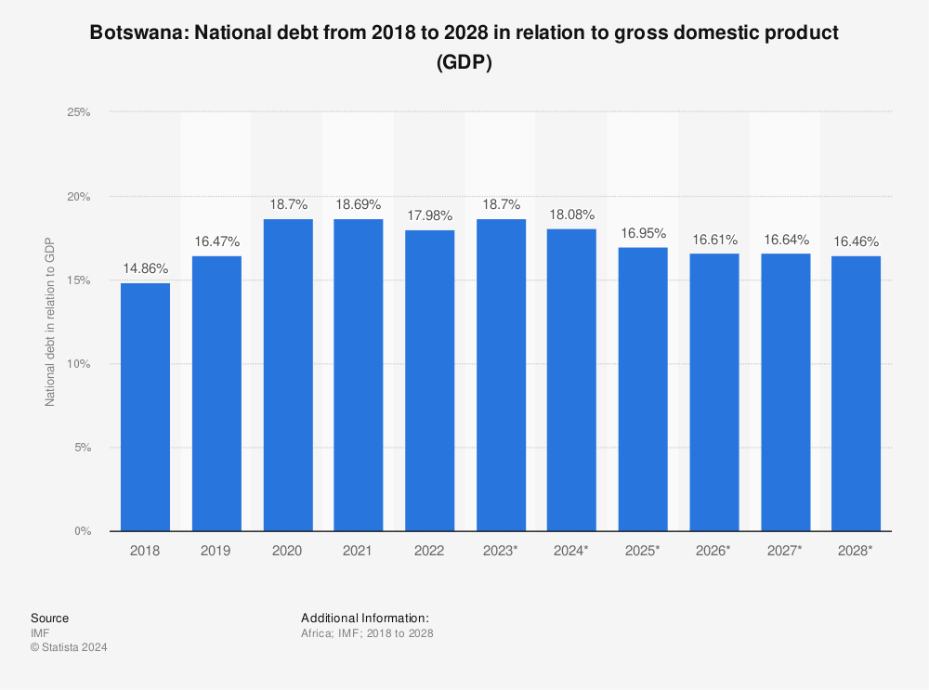
Botswana Debt to GDP

Slide 15
Global GDP Growth Rate
8
6.2
6
IMF
Projections
4.5
4.5
4.4 4.4
4.5
4
4
3.3
3.4
3.3
3.5
3.2
3.1
2.8
3.1 3.1
2.8
3.1 3.1
2.7
2.6
percentage
2
2.3
2.1
2
0
-1.3
-2
2008 financial crises
-3.1
Covid-19
-4
2000 2001 2002 2003 2004 2005 2006 2007 2008 2009 2010 2011 2012 2013 2014 2015 2016 2017 2018 2019 2020 2021 2022 2023 2024 2025

Slide 16
World Output, Annual % Changes (2005-2028)
8
Advanced Economies Emerging Market and Developing Economies Sub-Saharan Africa
6
4
2
0
2005-2014
2015
2016
2017
2018
2019
2020
2021
2022
2023
2024
2028
-2
-4
-6

Slide 17
GDP Growth Rates of Major Recessionary Economies
Japan United Kingdom Germany
30
25
20
15
10
5
0
-5
-10
-15
-20
-25
-30

Slide 18
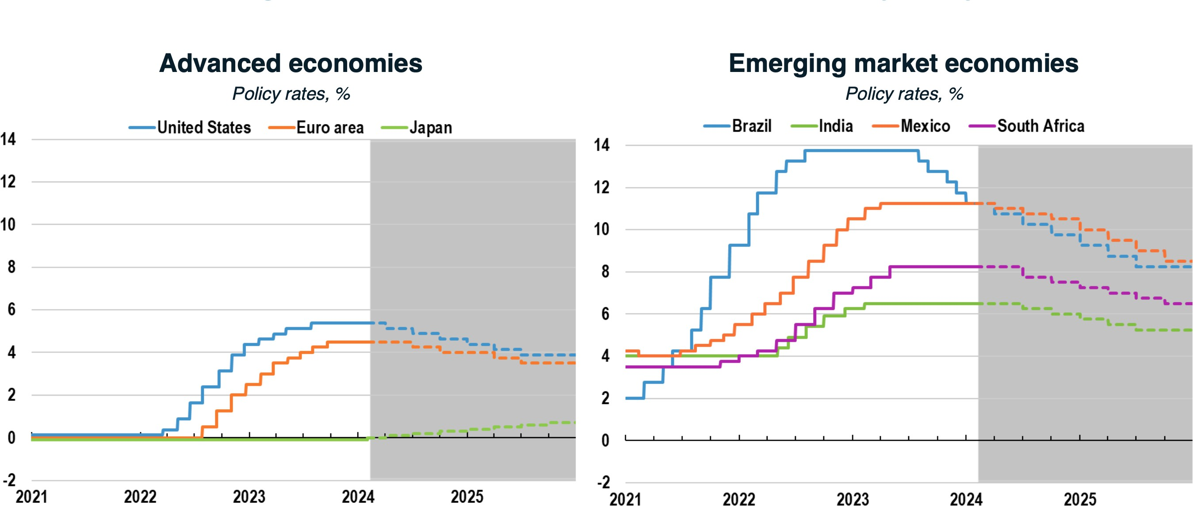
Monetary Policy Expected to React to Easing Inflation

Slide 19
GDP Growth Rate of Sub-Saharan Africa
8
Actual IMF Projections
7
6.6
6.3
6
6.1 6.1
6
6
5.1
5.1
4.9
5
4.3
4.1
4.2
4.1
4
4.1
4
3.5
3.8
3
3.3
3
2.7
2.9
2.7
2.6
2.4
%
2
1.3
1
0
-1
-2
-2
-3
2000 2001 2002 2003 2004 2005 2006 2007 2008 2009 2010 2011 2012 2013 2014 2015 2016 2017 2018 2019Co2v0i2d0-129021 2022 2023 2024 2025

Slide 20
Inflation
8
actual
forcast best case
worst case
BON
7
6.7
6.7
6.2
6.1
6
5.9
5.6
5.4
5.2
4.8
4.6
4.9
5
5
4.3
4
4
4
3.7
3.6
3.4
3.2
3
3
2.2
2
1
0
2010 2011 2012 2013 2014 2015 2016 2017 2018 2019 2020 2021 2022 2023 2024 2025

Slide 21
Quarterly GDP by Activity % share to GDP, 2023
Q1 Q2 Q3
18.0
16.0
14.0
12.0
10.0
16.9
15.4
15.9
11.7
12.2
10.4 _{10.1}
11.2
10.3
9.0
9.6
9.8
9.08.8
8.0
6.0
4.0
2.0
0.0
8.1
8.6
6.5
6.0
6.76.6
5.5
3.7
3.9
3.4
4.1
4.1
3.6
3.5
3.2
2.6
2.6
3.1
3.13.1
2.7
%
1.5
1.31.4^{1.6}
1.31.41.3
2.1
^{2.2}2.12.0
0.7
1.0
0.7
1.00.9

Slide 22
GDP Growth Rate, Namibia
15
Election year
Actual Forecast
12.3
10
7.1
Election year
5.4
6
5.6
6.1
4.8
5.1 5.1
4.6
Election year
5
4.2
4.3
3.9
3.5
Election year
3.4
3.1
2.5
2.6
2.7
%
1.2
1.1
Election year
0.3
0.08
0
-1
-0.8
Drought
Fiscal consolidation
-5
-8
Covid-19
2000 2001 2002 2003 2004 2005 2006 2007 2008 2009 2010 2011 2012 2013 2014 2015 2016 2017 2018 2019 2020 2021 2022 2023 2024 2025
-10

Slide 23
Government Revenue in billion N$
80000
70000
Election year
60000
Election year
50000
40000
N$ Billions
30000
Election year
20000
Election year
10000
0
2000 2001 2002 2003 2004 2005 2006 2007 2008 2009 2010 2011 2012 2013 2014 2015 2016 2017 2018 2019 2020 2021 2022 2023
Income & Profits Tax Property Tax Value Added Tax
International Trade Transactions other tax Entreprenurial and Property Income
Fines and Forfeitures Admin fees Return of Capital from Lending and Equity Grants

Slide 24
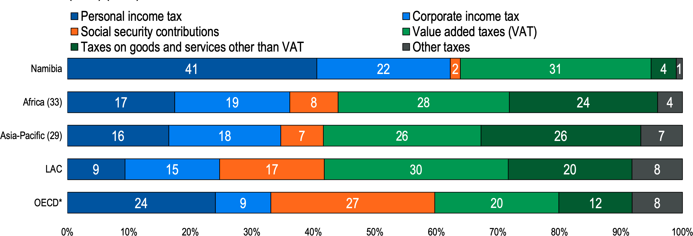
Tax diversity

Slide 25
Tax as a % of GDP

Slide 26
Total Government Expenditure YoY % Growth rates
80.0
70.0
60.0
50.0
40.0
30.0
Election year
20.0
Election year
Election year
10.0
Election year
Election year
0.0
1998 1999 2000 2001 2002 2003 2004 2005 2006 2007 2008 2009 2010 2011 2012 2013 2014 2015 2016 2017 2018 2019 2020 2021 2022 2023
-10.0
-20.0

Slide 27
Development vs Operational Expenditure
Election year
Stimulus Package (8 billion) End of EPZ
10% Dividend Tax
VAT Listed Asset Managers 25% Fuel Levy Increase Environmental Tax
Pre-Covid
Development Operational
70000.0
Election year: SACU Windfall, Mass Housing
Air Namibia 1.8 bill
60000.0
(3years)
NAMPORT Terminal
50000.0
Election year: Increase in Pension contribution, Completion of State House, Special Disease Program
Election year: Tax Cuts for the ”Poor”, Milk and Sugar added tax Exemption,
War veterans,
Air Namibia bail-out
N$ millions
40000.0
30000.0
20000.0
Election year: Corporate Tax 40% to 35%
10000.0
0.0
1997 1998 1999 2000 2001 2002 2003 2004 2005 2006 2007 2008 2009 2010 2011 2012 2013 2014 2015 2016 2017 2018 2019 2020 2021 2022 2023

Slide 28
% Allocation by sector
100%
90%
80%
70%
60%
50%
40%
30%
20%
10%
0%
1990 1991 1992 1993 1994 1995 1996 1997 1998 1999 2000 2001 2002 2003 2004 2005 2006 2007 2008 2009 2010 2011 2012 2013 2014 2015 2016 2017 2018 2019 2020 2021 2022 2023
home affairs and immigration finance
Urban and rural development national planing commision
safety and secuirity eduaction, arts and culture
Agriculture, water and rural development Higher education, training and inovation
defence
health and social service transport
others

Slide 29
Expenditure on the Health Sector in Billion N$
Censored Headcount Ratios by Regions
10,000,000,000
Drinking water
Access to Clinics and Hospitals Child Nutrition
Sanitation Food Security
9,000,000,000
8,000,000,000
90
7,000,000,000
80
70
6,000,000,000
60
5,000,000,000
50
4,000,000,000
40
30
3,000,000,000
20
2,000,000,000
10
1,000,000,000
-
0
2004
2005
2006
2007
2008
2009
2010
2011
2012
2013
2014
2015
2016
2017
2018
2019
2020
2021
2022
2023

Slide 30
Expenditure on the Education Sector in Billion N$
Censored Headcount Ratios by Regions
18,000,000
School Attendance(at least
one school aged child (aged 7-17 years) is not attending
school.
Years of Schooling(16 years or older have not completed
7 years of schooling.
16,000,000
40
14,000,000
35
12,000,000
30
10,000,000
25
8,000,000
20
6,000,000
15
4,000,000
10
5
2,000,000
0
-
2004
2005
2006
2007
2008
2009
2010
2011
2012
2013
2014
2015
2016
2017
2018
2019
2020
2021
2022
2023

Slide 31
Total Government Expenditure 1990-2023
Education 18%
Defence 9%
Health 9%
Finance 6%
Agriculture 5%
Gender equality, Poverty eradication
4%
Safety and Security 5%
Higher education 3%
Land Resettlement 3%

Slide 32
Type of Debt
160000
Domestic Debt Foreign Debt
140000
120000
100000
80000
60000
40000
20000
0
N$ millions
1990
1991
1992
1993
1994
1995
1996
1997
1998
1999
2000
2001
2002
2003
2004
2005
2006
2007
2008
2009
2010
2011
2012
2013
2014
2015
2016
2017
2018
2019
2020
2021
2022
2023

Slide 33
Revenue as a % of Debt
total Debt Debt to Revenue (rhs)
160000
250%
140000
200%
120000
100000
150%
80000
60000
100%
40000
50%
20000
0
0%
2008 2009 2010 2011 2012 2013 2014 2015 2016 2017 2018 2019 2020 2021 2022 2023

Slide 34
Government Debt and Maturity Dates
12,000,000,000
10,000,000,000
8,000,000,000
6,000,000,000
4,000,000,000
2,000,000,000
0

Slide 35
Government Expenditure Efficiency
Inflation rate GDP growth rate Government Expenditure (rhs)
15.0
80000
70000
10.0
60000
5.0
50000
percentage
N$ millions
40000
0.0
30000
20000
-5.0
10000
-10.0
0
1995
1996
1997
1998
1999
2000
2001
2002
2003
2004
2005
2006
2007
2008
2009
2010
2011
2012
2013
2014
2015
2016
2017
2018
2019
2020
2021
2022

Slide 36
Credit Rating
A+
Fitch
Moodys (rhs)
A1
Non Investment Grade
A-
A3
BBB
Baa2
BB+
Ba1
BB-
Ba3
B
B2
CCC+
Caa1
2005 2006 2007 2008 2009 2010 2011 2012 2013 2014 2015 2016 2017 2018 2019 2020 2021 2022

Slide 37
Government Guarantees
14000
12000
10000
8000
N$ millions
6000
4000
2000
0
2001 2002 2003 2004 2005 2006 2007 2008 2009 2010 2011 2012 2013 2014 2015 2016 2017 2018 2019 2020 2021 2022 2023

Slide 38
Tax Amendments
1992 | Corporate tax reduced from 42% to 40%
1992 | Mining tax slit into two categories: diamond mining and other mining
1993 | Corporate tax reduced from 40% to 38%
1993 | General sales tax reduced from 11% to 8%
1993 | Creation of “manufacturing incentive tax”
1993 | Creation of “additional sales levy”
1995 | Corporate tax reduced from 38% to 35%
1995 | Creation of “export processing zone” tax incentives
1999 | Restructuring of diamond mining tax
2000 | Creation of VAT to replace general sales tax and additional sales levy
2002 | SACU revenue sharing formula updated
2004 | Creation of mining royalty tax

Slide 39
Tax Amendments (cont.)
2006 | Creation of land tax
2008 | Creation of minerals royalty and windfall tax
2009 | Creation of withholding tax on interest
2011 | Creation of of withholding tax on services
2011 | Corporate tax reduced from 35% to 34%
2013 | Corporate tax reduced from 34% to 33%
2016 | Creation of environmental levies
2016 | Creation of “import levy”
2016 | Corporate tax reduced from 33% to 32%
2018 | Introduction of “sin” tax
2020 | Manufacturing and export process zone incentives are scrapped
2022 | Zero VAT rating on sanitary pads

Slide 40
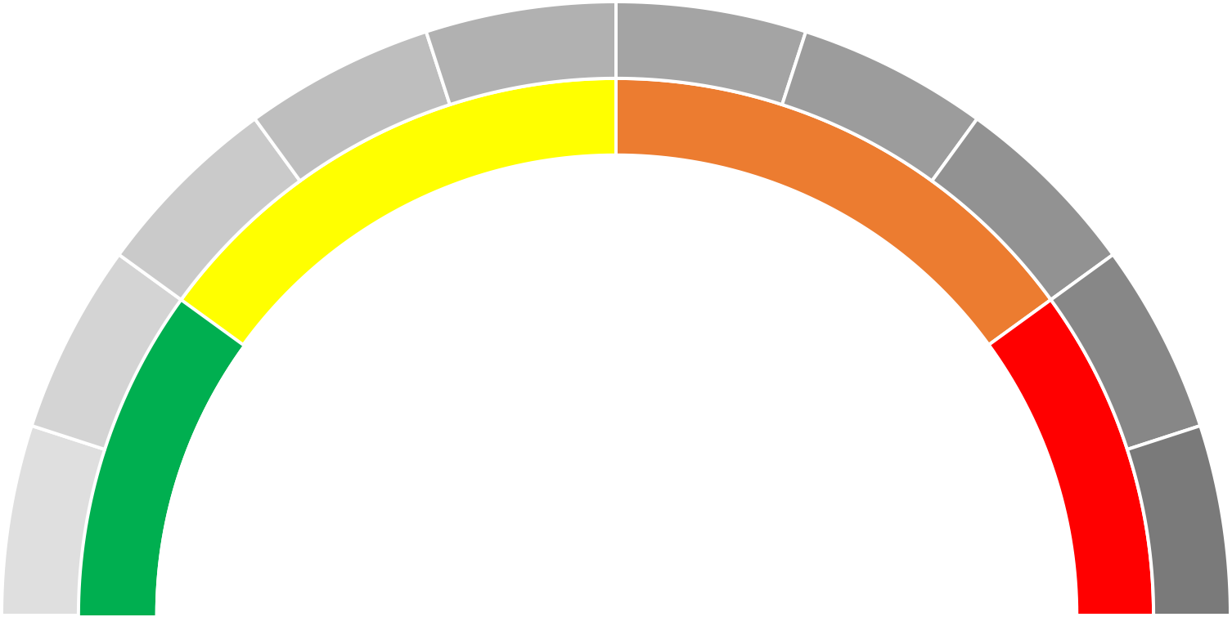
Debt as a % of GDP
50%
60%
40%
70%
30%
80%
20%
90%
10%
100%
65.6%

Slide 41
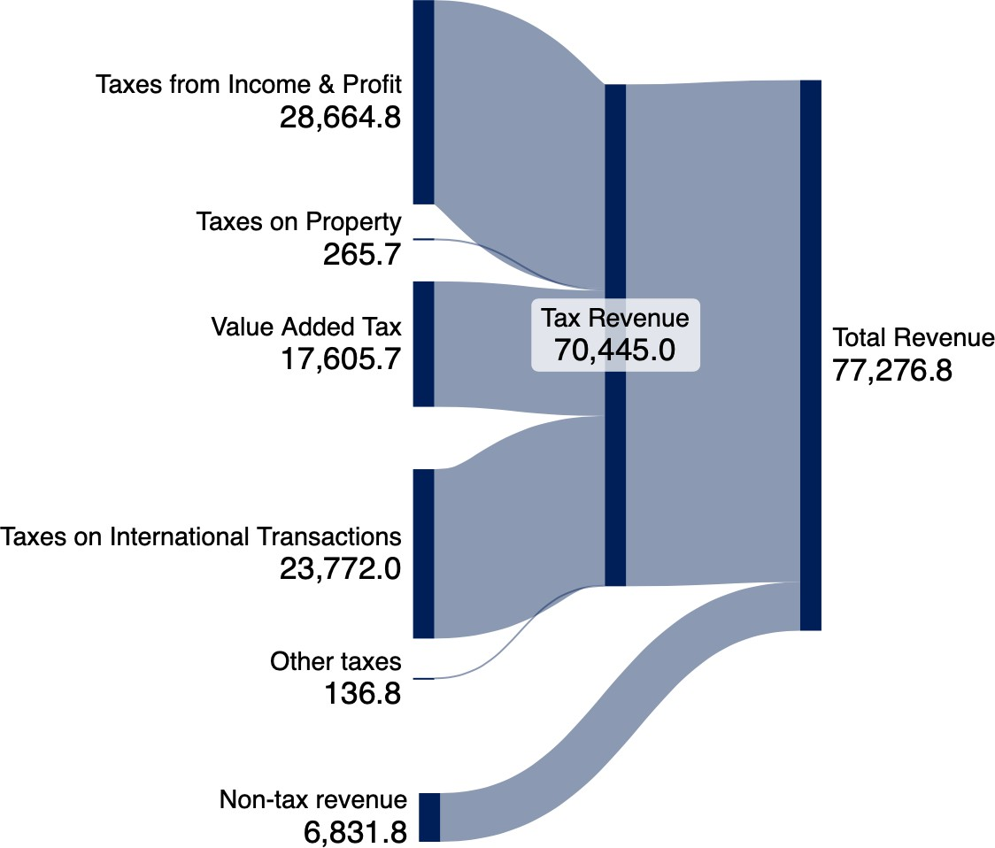
Expected Government Revenue Breakdown 2024

Slide 42
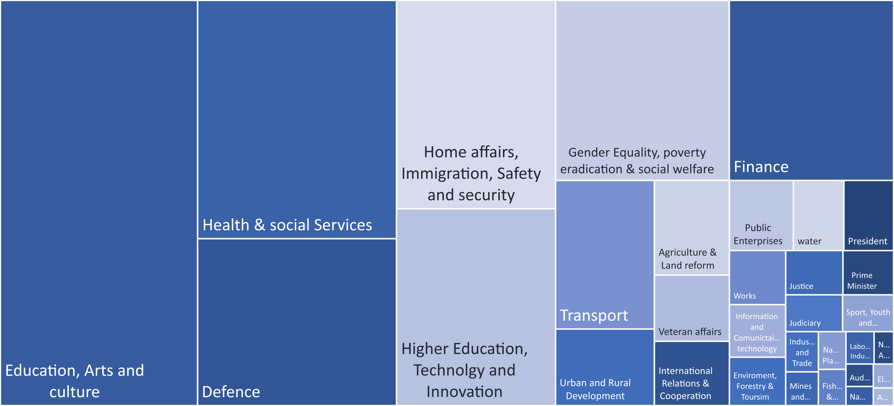
Expected Government Budget Allocation 2024

Slide 43
Key risks to the positive domestic outlook : 2024
Fluctuations in commodity prices
Uncertainties related to elections
a possible recession in the South African economy,
Continued uncertainty over the investment environment
Slow progress on power generation
Growing Public Debt
Global Developments
High cost of living
High costs of key import items
Water supply interruptions affecting mining activities
Potential impacts of weather conditions on food prices
Drought

Slide 44
Budget Statement EXPECTATIONS
Expansionary Budget WHY?
Revenue Collection improved drastically
Potential Fuel Levy Increase
Environmental Levies
SACU Revenue
Potential Green Bond Issuance (EIF)
Expansionary Budget WHERE?
SOE Reforms (HYBRID) (MEATCO AND RCC)
SME BANK II (CORRIDOR TALKS)
Construction Sector Recovery (Hospitals and Schools)
Agri-Sector (Agri-Bank and Green Schemes)
NWR (Potential Expansions)
SOCIAL SAFETY NET
Grey Areas
Investment Promotion and Facilitation Bill
Oil and Gas Local Content Policy
No Exports of Raw Materials (White Paper)
HANG MUNICIPALITIES

Slide 45
Thank you.

