Slide 1


The National Budget at a Pivotal Moment: Choices, Trade-offs and Economic Direction
17 February 2026

Slide 2
Outline
Global, Regional and Domestic Outlook
Budget Trends
Choices, Trade Offs & Direction
Economic Direction
Conclusion

Slide 3
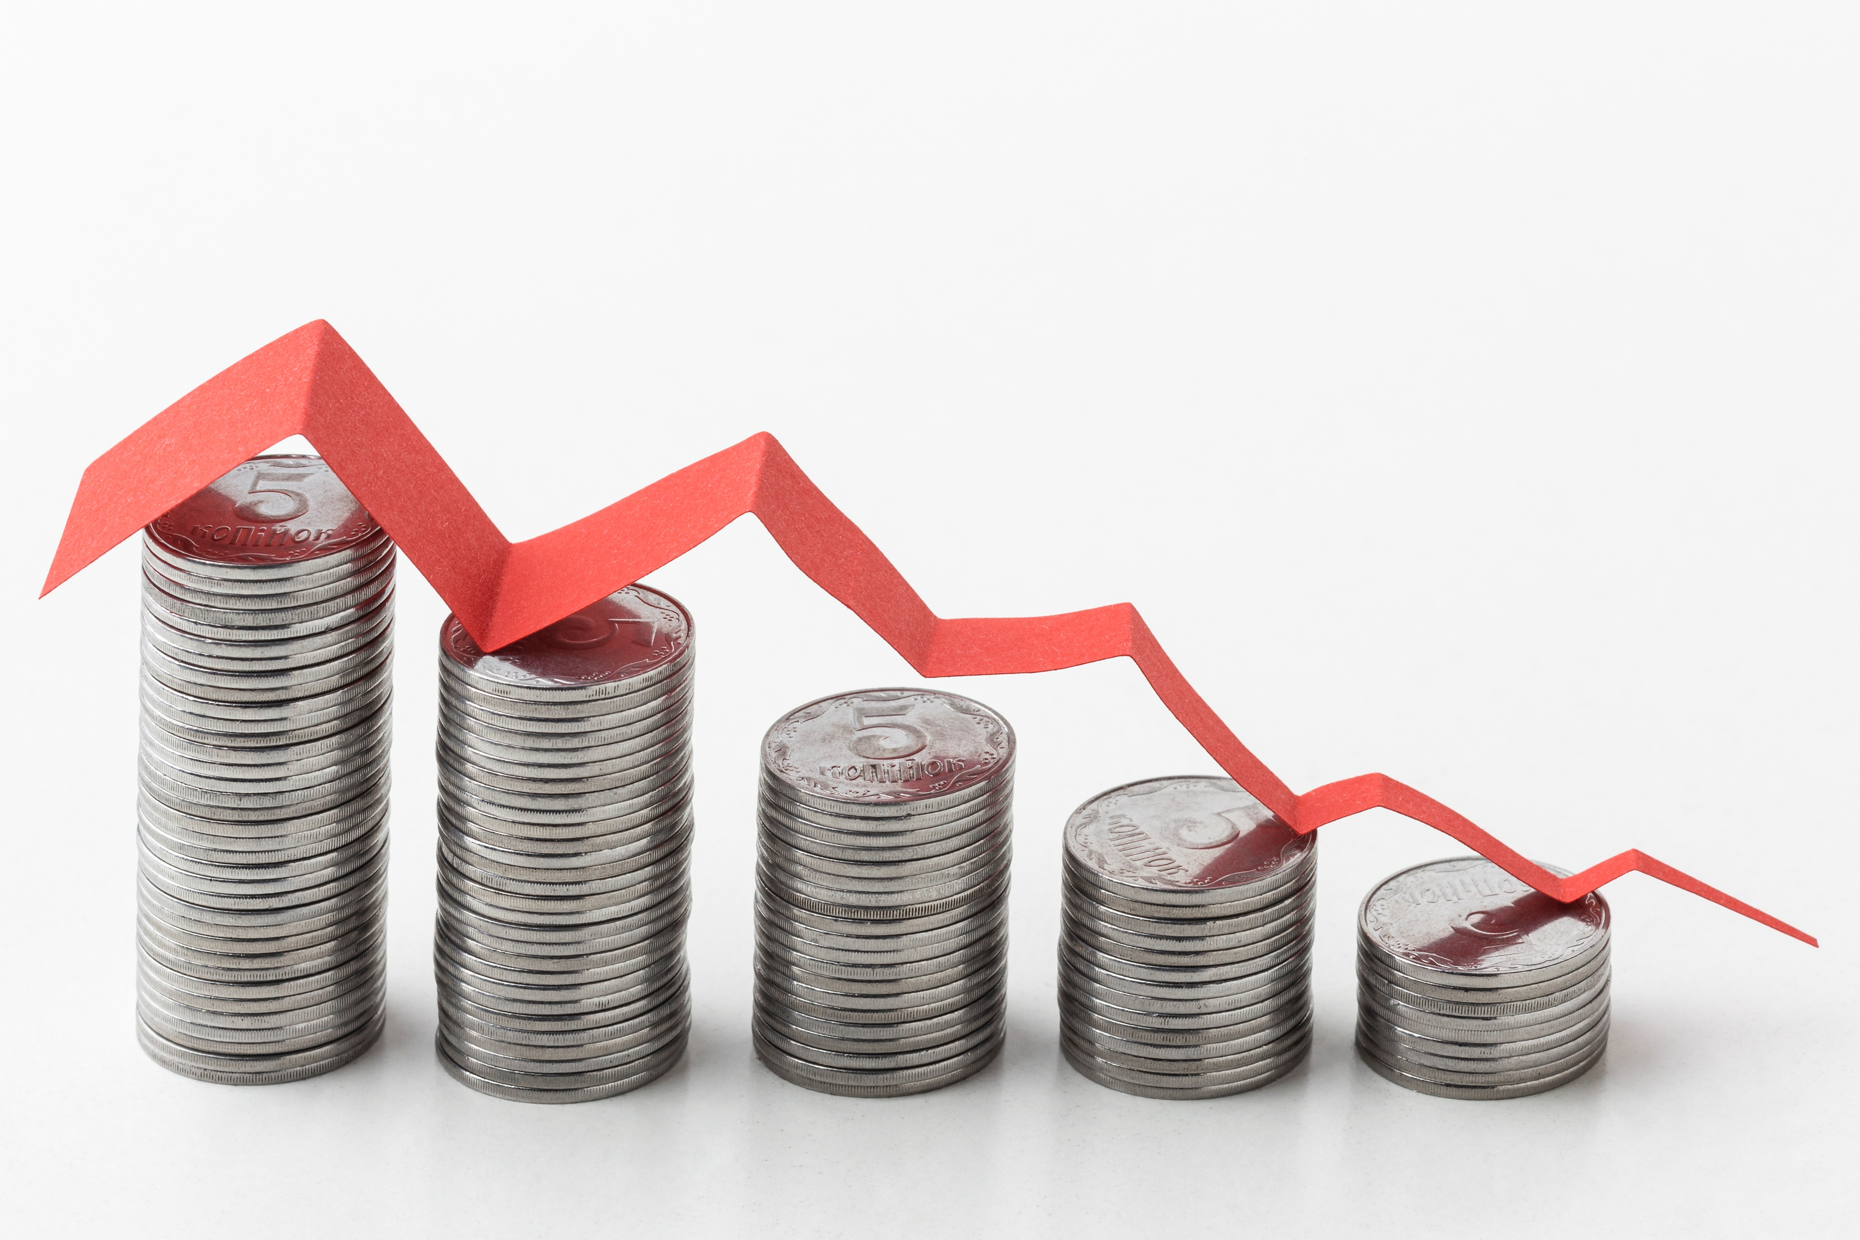
Global, Regional and Domestic Outlook

Slide 4
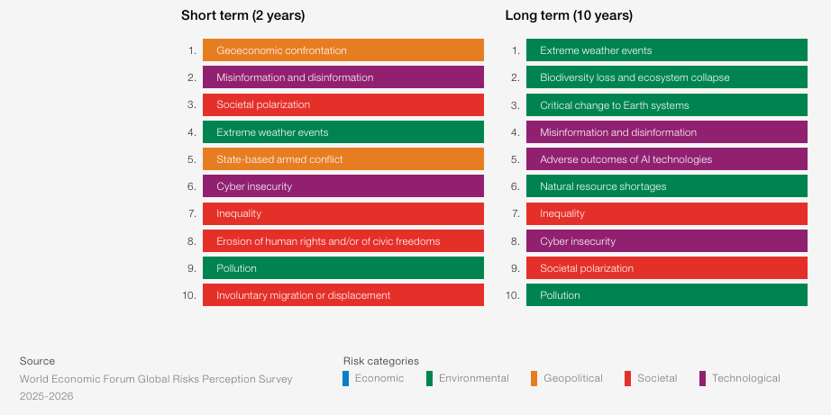

Global risks ranked by severity, short term (2 years) and long term (10 years))

Slide 5
Global Economic Outlook
Source: IMF Jan 2026 Updated Estimates

Slide 6
Namibia & SA GDP vs Sub-Saharan Africa 2006-2024
Source: NSA, Stats SA & IMF

Slide 7
GDP Contribution by Industry % (1981-2024)
Source: NSA

Slide 8

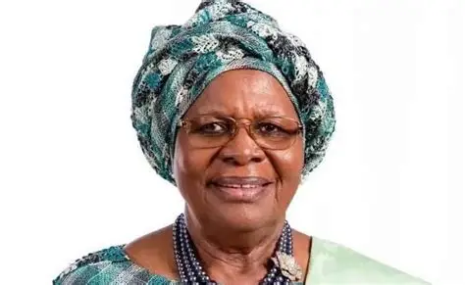

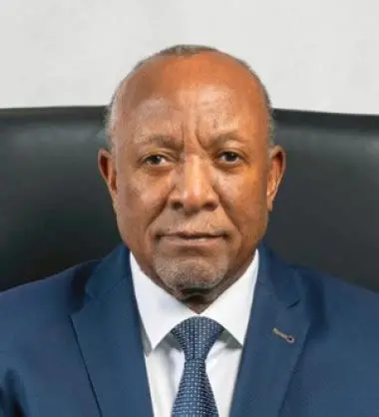

Namibian GDP
Election Year
Source: NSA & BoN
Projected Figure

Slide 9
Key Social Challenges- Youth Unemployment (Census Labour Report 2023)
Source: NSA

Slide 10

Budget Trends

Slide 11
Taxpayer & Portal Registration
Registration figures as of | 31-Jan-25 | 31-Dec-25 | Percentage Change
Total Registered Taxpayers | 1,092,862 | 1,150,405 | 5.27%
Active Taxpayers | 1,000,052 | 1,055,978 | 5.59%
Registered on ITAS Portal | 564,504 | 633,879 | 12.29%
Source: Namibia Revenue Agency (NAMRA)

Slide 12
NAMRA Revenue Collection
2025/26 Revenue Estimate
N$ 88,999,000,000
As of 31 December 2025
68.60%
OR
N$ 61,056,144,655 Collected
Source: Namibia Revenue Agency (NAMRA)

Slide 13
Tax Revenue & Non-Tax Revenue Collections FY 2023/24 – 2025/26 Projections
1.13% decrease in tax revenue
69.49% increase in non-tax revenue
Source: Ministry of Finance (MoF)
Notes:
What are the "SAD500 Declarations"?
The SAD500 (Single Administrative Document) is the official customs form used in Namibia (and across the Southern African Customs Union) to declare goods.

Slide 14
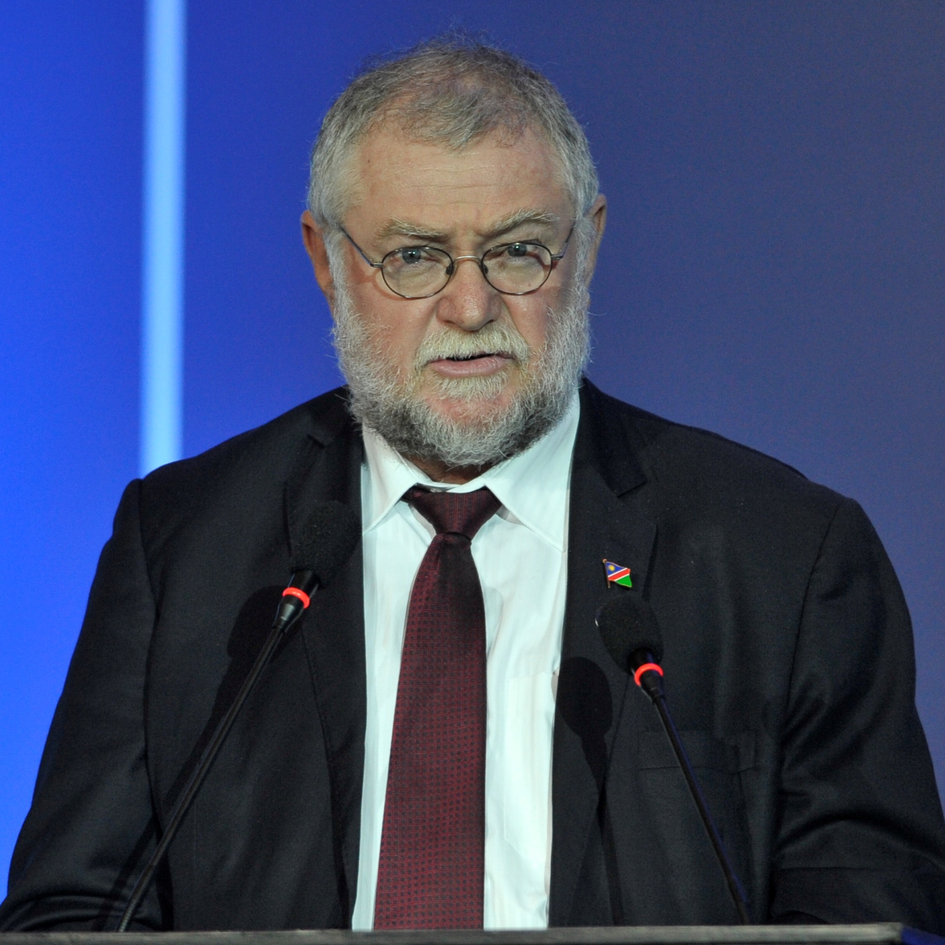
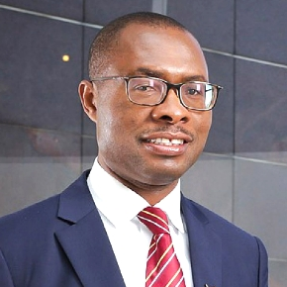

Fiscal aggregates as % of GDP
Pro-Poor and Pro-Growth Kudu Gas to Power Guarantees, National Oil Facilities
Fiscal Consolidation, Legacy Tax Liabilities, Fiscal Prudence
Budget Surplus, Inclusive Growth, and Fiscal Discipline
Source: Ministry of Finance (MoF)

Slide 15
2025/26 Budget Tax Policies and Administration Reforms
Zero-rated commercial properties – Now includes state-acquired properties.
Retirement funds commutation – Increased from N$50,000 to N$375,000.
VAT on imported digital services – Ensuring fair competition with local providers.
Annual housing tax benefit cap – Set at N$400,000 for fairness.
Anti-avoidance tax rule – Loans disguised as preference shares taxed as income.
Tax bracket adjustment postponed – Moved to FY2026/27 & FY2027/28, providing N$712.9 million relief per year.
Dedicated Tax Court – Legislation expected in FY2025/26.
Corporate tax rate reduction – From 30% (Jan 2025) to 28% (FY2026/27).
Corporate tax base expansion – Includes a 30% interest deduction limit, loss carry forward cap, and a 10% dividend tax (Jan 2026).
Special Economic Zones (SEZ) regime – SMEs get a 20% corporate tax rate.
E-invoicing system for VAT – Launching April 2026 to reduce fraud.
Tax amnesty extension – Until 31 October 2026, allowing penalty & interest write-offs.
Excise duty increase – 6.75% hike on alcohol & tobacco from 12 March 2025.

Slide 16
2025/26 Budget Highlights: Top Budget Allocations in N$’’000, for the FY2025/2026
The FY2025/26 budget was presented under the theme “Beyond 35: For a Prosperous Future”, marking 35 years of Namibia's independence and emphasised efforts toward a more inclusive and equitable economy.
The Budget Policy focuses on four main areas:
Economic Development: Continued investments in infrastructure like housing, education, water, power, and healthcare to create economic opportunities and provide social services.
Social Protection: Sustaining support for vulnerable communities, ensuring livelihoods, empowering youth, and maintaining social progress despite economic challenges.
Youth Empowerment: Allocating funds for youth programs and capacity-building activities.
Food Security: Supporting initiatives to boost food production and agricultural activities, especially in light of drought challenges, to enhance national food security.

Slide 17
Budget Allocation Trend 2025/26
?
Source: Ministry of Finance (MoF)

Slide 18
The Petroleum Amendment Bill (2025) and The Investment Promotion and Facilitation Bill
1. Petroleum Amendment Bill (2025)
New Regulator: Creates the Upstream Petroleum Unit (UPU) under the President, taking over licensing and oversight from the Ministry of Mines & Energy.
Local Content Law: Requires International Oil Companies to submit Local Content Plans and prioritize Namibian labour and goods.
Asset Disclosure: Director-General and Deputy must disclose financial assets to combat corruption.
Consolidated Oversight: Establishes a single window for technical, fiscal, and environmental regulation in the petroleum sector.
2. Investment Promotion and Facilitation Bill (NIPFB)
Reserved Sectors: Certain small-scale businesses (e.g., retail, agriculture under N$7.5 million) reserved for Namibians.
Strategic Sectors: Investment in sectors like Mining, Oil & Gas, and Energy requires ministerial approval and may require 25–33% Namibian ownership.
Performance Agreements: Investors may sign agreements tying investments to job creation, technology transfer, or other targets.
One-Stop Shop: Formalizes NIPDB to streamline visas, permits, and approvals, reducing bureaucratic delays.

Slide 19
Choices, Trade-offs

Slide 20
HPP I (2016-2020)
Pillar 1: Effective Governance | Pillar 2: Economic Advancement | Pillar 3: Social Progression | Pillar 4: Infrastructure Development | Pillar 5: International Relations and Cooperation
Accountability & Transparency | Macro-Economic Stability | Hunger Poverty | Energy Infrastructure | Respected and trusted International Community member
Improve Performance & Service Delivery | Economic Transformation | Residential Land Delivery, Housing & Sanitation | Water Infrastructure | International Support for Economic Independence
 | Youth Enterprise Development | Infant & Maternal Mortality | Transport Infrastructure
 | Economic Competitiveness | Vocational Education Training | ICT Infrastructure

Slide 21
HPP II (2021-2025)
Pillar 1: Effective Governance | Pillar 2: Economic Advancement | Pillar 3: Social Progression | Pillar 4: Infrastructure Development | Pillar 5: International Relations and Cooperation
Accountability & Transparency | Optimize Stewardship of Natural Resources & Public Assets | Zero Deaths from Hunger Poverty | Energy Supply Security | Enhance Economic Diplomacy for Economic Recovery
Strengthening the National Anti-Corruption Mechanisms | Enhance Productivity of Priority Economic Sectors | Delivery of Urban Land, Housing & Sanitation | Water Supply Security
Improved Performance & Service Delivery | Develop Complementary Engines of Growth | Improved Access to Healthcare | Strengthen Namibia's Position as a Transport and Logistics Hub
Enhanced Citizen Participation & Engagement |  | Improved Access to Quality Education & Sports | Expand Coverage for Information and Communication Technologies
Enhancing Security & Rule of Law |  | Arresting Gender Based Violence and Violence Against Children

Slide 22
Development Plans (2016 – 2030)
HPP1 (2016 -2020) HPP2 (2021 – 2025) | NDP 5 (2017 - 2025) | NDP 6 (2025 – 2030) | SMIP (2025 – 2030)
Pillars | Pillars | Pillars | Critical Success Factors
Pillar 1: Effective Governance | Pillar 4: Good Governance | Pillar 4: Effective Governance and Public Service Delivery | Procurement reform Performance and consequence management Monitoring frameworks Transparency mechanisms Meritocracy and ethical leadership
Pillar 2: Economic Advancement | Pillar 1: Economic Progression | Pillar 1: Economic Growth, Transformation and Resilience | Mineral beneficiation acceleration Local content policy SOE reform PPP and private sector mobilisation
Pillar 3: Social Progression | Pillar 2: Social Transformation | Pillar 2: Human Development and Community Resilience | Housing Education Health Youth programmes

Slide 23
Development Plans (2016 – 2030)
HPP1 (2016 -2020) HPP2 (2021 – 2025) | NDP 5 (2017 - 2025) | NDP 6 (2025 – 2030) | SMIP (2025 – 2030)
Pillars | Pillars | Pillars | Critical Success Factors
Pillar 4: Infrastructure Development | Pillar 1: Economic Progression Economic Infrastructure | Pillar 3: Environmental Sustainability | Centralised project management Procurement reform Budget alignment Oversight of special project task teams
Pillar 5: International Relations & Cooperation | Pillar 1: Economic Progression | Pillar 1: Economic Growth, Transformation and Resilience | Improved transparency PPP credibility Institutional reform that strengthens investor confidence

Slide 24
SMIP Top 7 Priority List
Agriculture
Enhance food security and reduce food imports.
Sports
Build basic sports infrastructure in all 121 constituencies.
Youth Empowerment
Establish a National Youth Fund (N$500 million annually).
Quality Education and Training
Provide free higher education and vocational training.
Creative Industry
Establish national arts and creative industry awards.
Quality Health and Social Welfare
Expand access to healthcare, especially in rural areas.
Land, Housing and Sanitation
Construct 50,000 affordable houses by 2029.
Develop 130,000 hectares of large-scale farms.
Expand Green Schemes to 100% capacity.
Integrate small-scale farmers into value chains.
Mass formalization of informal settlements.
Build 1,000 sanitation facilities (20,000 units).
Provide funding for studios, facilities, and equipment.
Develop infrastructure to support local talent.
Provide funding for 6,000 youth-owned businesses annually.
Create youth apprenticeship and internship programs.
Construct CAF Category 2 & 3 stadiums.
Establish Sports Centres of Excellence.
Invest N$25 billion over five years in education infrastructure.
Expand and upgrade HEI and TVET institutions.
Build 11 new intermediate hospitals.
Strengthen emergency medical services and recruit 8,134 healthcare personnel.

Slide 25

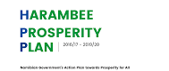
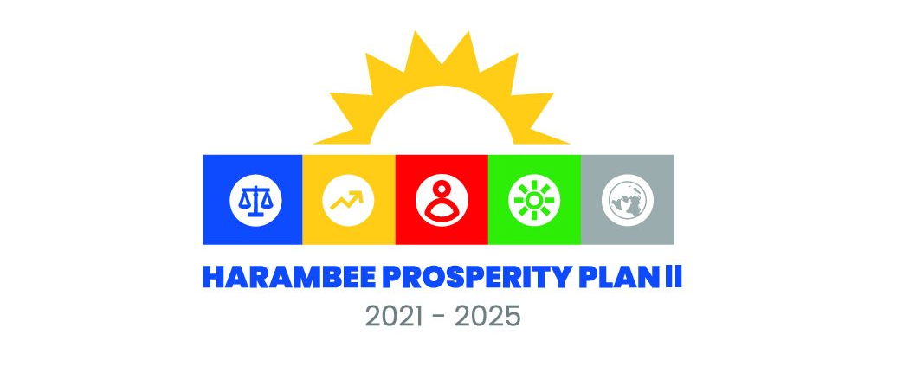
Economic Goals & Direction

Slide 26
Economic Direction Emerging from the Mid-Year Review
1. Growth Recalibrated
2025 growth revised down to 3.3%
MTEF growth lowered to ~3.6% average
Manufacturing weakness offset by uranium and gold strength
Signal: Growth expectations are being reset to a more moderate path.
2. Fiscal Envelope Fixed, Priorities Reordered
Total appropriation remains N$89.4bn
Development spending reduced
Operational spending increased via reallocation
Education and health personnel protected
Signal: No expansion. Reprioritisation within constraint.
Notes:
Signal:
Shift from expansionary developmentalism → toward constrained developmentalism.

Slide 27
Economic Direction Emerging from the Mid-Year Review
3. Debt & Sustainability Anchored
Public debt: N$176.3bn
Debt servicing: 16.1% of revenue
Baseline described as “highly undesirable” if unattended
Signal: Stabilisation now central to policy direction.
4. Strategic Pivot Underway
Medium-Term priorities include: Medium-Term Revenue Strategy
SOE-led growth model
Diversified financing via guarantees
Public expenditure reviews
Primary balance discipline
Signal: Shift from expansionary developmentalism → toward constrained developmentalism.
Notes:
Signal:
Shift from expansionary developmentalism → toward constrained developmentalism.

Slide 28
The Pivotal Moment
Structural Ambition
NDP6 industrial transformation
Employment & productivity targets
Fiscal Constraint
Growth revised to approx. 3.0%
Revenue shortfall emerging
Debt servicing at 16.1% of revenue
The Core Question
Is Namibia ready to accelerate transformation with policy certainty?

Slide 29
THANK YOU.

